Slide 1
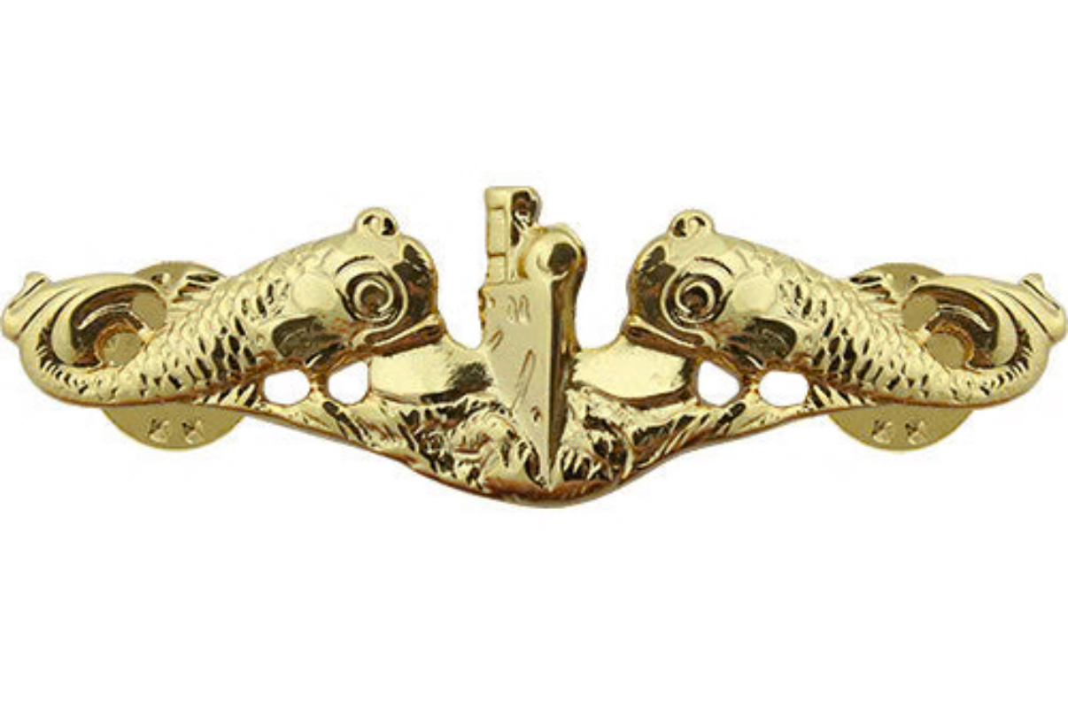
Welcome & Introduction
Marlon Terrell
IG: @imdterrell
Email: marlon.terrell@gmail.com
M: 214-558-2097
calendly: www.calendly.com/marlon23

Slide 2
1. Talk to Trusted Mentors
• Find mentors who truly have your best interests at heart
• Ask what you can do for them – relationships are mutual
• Seek their insight on transition options and long-term strategy

Slide 3
2. Understand Your SELRES/IRR Options
• Explore CANREC, BGO, and other Active Reserve opportunities
• Align reserve roles with your interests and long-term goals
• Don’t miss hidden opportunities in the Reserve community

Slide 4
3. Ask Your SELRES/IRR Peers
• Peer networks offer real-time advice and lived experience
• Understand pathways: Business school, Med school, Fast track roles, Entrepreneurship, Learn the roadmap and required qualifications

Slide 5
4. Don’t Forget What You Learned
You served in one of the most efficient and well-led organizations
Leadership, systems thinking, mission focus – these are assets
Don’t let frustration push you to undervalue your experience

Slide 6
5. Use LinkedIn Strategically
Build a strong profile that highlights your military value
Connect with peers, mentors, and potential employers
Share your journey – people want to help if they see your story

Slide 7
6. What I Didn’t Know
I would have invested my money, not just saved it
Learn to invest – especially if you’re entrepreneur-minded
Financial advisors help, but question everything
Real estate, VC, stocks, PE – now I’m more investor than operator
Consider franchising or buying a business, not always building one

Slide 8
7. Final Tip: File Your Disability Claim
You earned it – don’t leave benefits on the table
Start early, be thorough, and get help if needed
It’s not just about money – it’s recognition for your service
You don’t have to have much documentation, just do it.
You don’t know what ailments may arise as you get older.

Slide 9
Thank You & Q&A
Thank you for your service
Stay connected, stay intentional
Let’s open it up for questions and discussion

