Slide 1
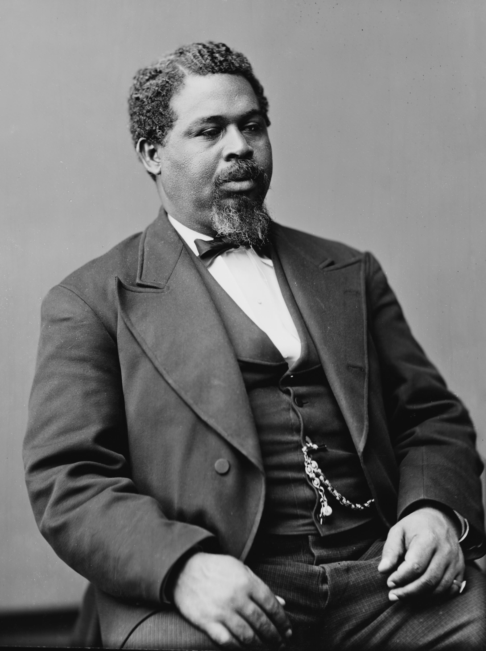
Who is Robert Smalls? Ex-slave, Deckhand, Ship Captain, Congressman
Born into slavery in 1839 in Beaufort, SC, he learned every aspect of sailing as a part of his daily tasks.
During the Civil War, he took the opportunity to break through enemy lines, and join causes with the United States Navy. His exceptional talents were rewarded with a commission.
Following the Civil War, Robert Smalls was elected to the US House of Representatives, representing South Carolina’s 5th and 7th districts.
What lessons can we draw today from this exceptional person?
Join us in celebrating this Navy “mustang”
Thursday 27 Feb from 1130-1230
La Novia Room in Herrmann Hall
POC: LT Brandon Carter (757) 581-1776 brandon.carter@nps.edu
Notes:
Photo of Robert Smalls: By Mathew Brady - This image is available from the United States Library of Congress's Prints and Photographs divisionunder the digital ID cwpbh.03683.This tag does not indicate the copyright status of the attached work. A normal copyright tag is still required. See Commons:Licensing for more information., Public Domain, https://commons.wikimedia.org/w/index.php?curid=1485179
Sketch of CSS Planter: By Unknown - Harper's Weekly, June 14, 1862, p. 372, Public Domain, https://commons.wikimedia.org/w/index.php?curid=31147539

Slide 2
Welcome to NNOA’s First Annual Black History Month Luncheon.
We’re going to confront slavery and its legacy in this country.
We’re going to talk about this uncomfortable past.
Don’t look away. This is not about you. This is about all of us.
“To understand where you’ve been is to know where you’re going” is not a cliché.
We will talk about why our history is important, and how knowing can make us stronger, together.

Slide 3
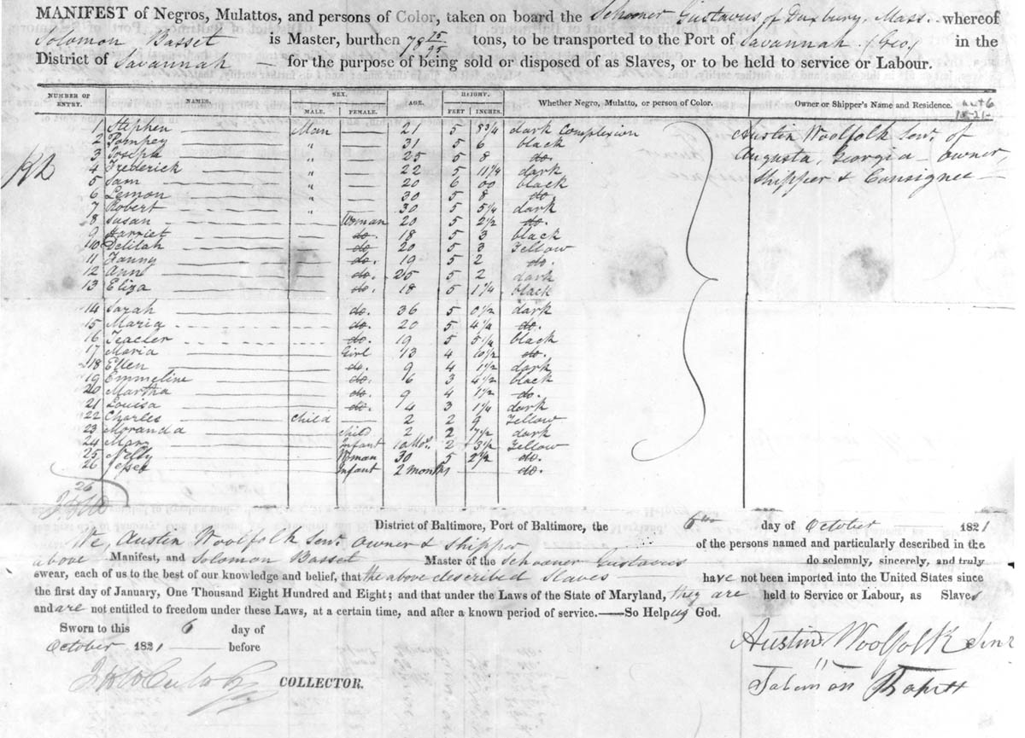
…for the purpose of being sold or disposed of as Slaves…
…dark…black…yellow…
…Man…Woman…child…infant…
…under the Laws of the State of Maryland, they are held to service as Slaves and are not entitled to freedom under these Laws…
So Help us God.
Notes:
https://www.archives.gov/files/publications/prologue/2000/winter/images/winter-2000-slave-manifest-l.jpg
This is a manifest from 1821 for the purpose of moving special cargo from Baltimore to Savannah.
This might be hard to read, so we’ve pulled out some of the key language.

Slide 4
Who was Robert Smalls?

Slide 5
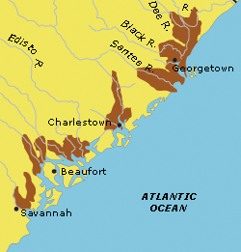
Slave
Born 5 April, 1839 in Beaufort, SC
His mother, Lydia Polite, was a slave.
His father is unknown, but it is suspected that it was Lydia’s owner, Henry McKee
The family hired him out as a day laborer at the docks.
He worked his way from rigger to sailor
He married Hannah Jones, also a slave, who was hired out as a hotel maid.
Notes:
nps.gov

Slide 6
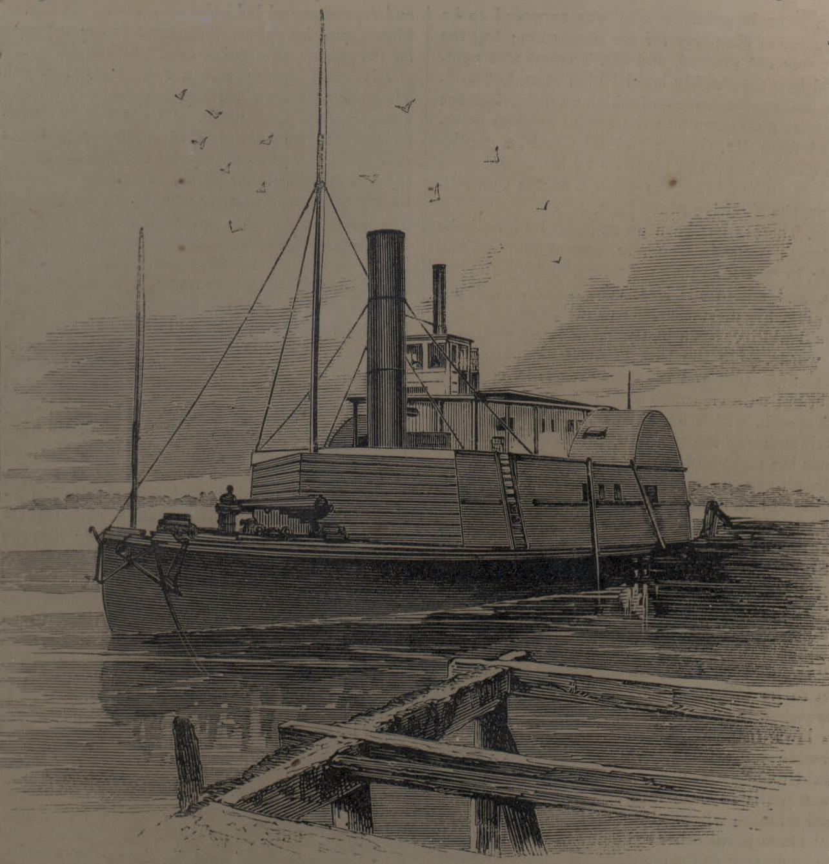
Sailor
In March 1861, he was hired out to the Confederate Navy as a deckhand for the CSS Planter.
The Planter was a supply ship, bringing supplies between the forts in Charleston Harbor.
Frequent trips through Charleston Harbor, coupled with his previous knowledge helped him devise a daring escape to freedom.
On 13 May, 1862, while the white captain and crew were ashore, Smalls and his fellow enslaved sailors slipped out to sea, picking up their families from a predetermined rendezvous point.
Using the Confederates challenge and pass, he sailed the ship through the blockade lines, and surrendered the ship to the Union Navy.

Slide 7
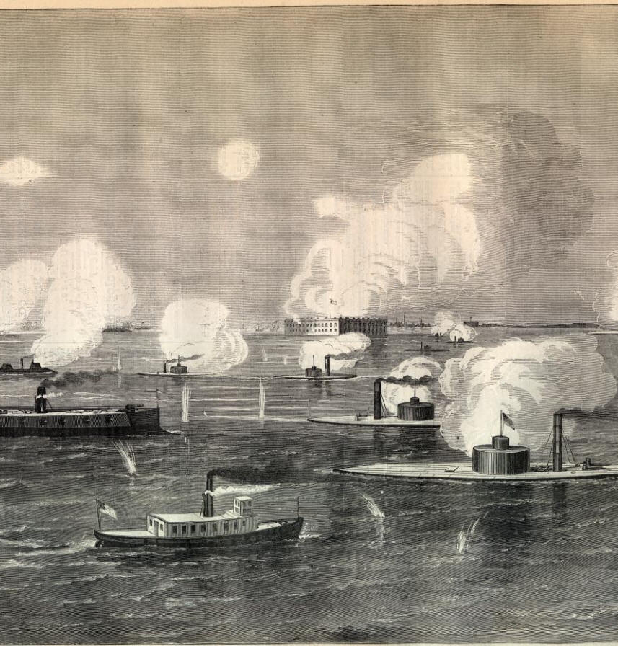
Captain
Prior to the Civil War, Smalls did not have the money required to purchase his freedom, and that of his wife and children (~$700). The appraisal of the Planter awarded Smalls $1500.
Though not yet formally commissioned, Smalls served as pilot on the Planter, participating in 17 military engagements.
He assumed command during one of these engagements when the captain was “so demoralized, he hid in the coal bunker.”
His battlefield actions earned him a commission and promotion to captain, earning $150 per month.
At the end of the war in April, 1865, Smalls was onboard the Planter in a ceremony in Charleston Harbor.
Notes:
https://www.pbs.org/wnet/african-americans-many-rivers-to-cross/history/which-slave-sailed-himself-to-freedom/
https://www.legendsofamerica.com/sc-fortsumter/2/

Slide 8
Congressman
Following the Civil War, Smalls bought his former owner’s house, taking in some of th the McKee family, who were destitute at this point.
He opened a general store, a school for African American children, and a newspaper.
He was elected to the State House of Representatives and State Senate, serving from 1868-1874
He was elected to the US House of Representatives, serving from 1874-1887. Representing the 5th and 7th districts.
Notes:
Library of Congress, prints and photographs division
due to gerrymandering.

Slide 9
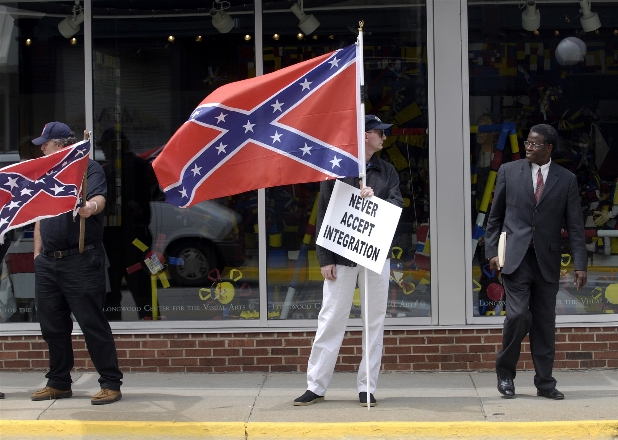
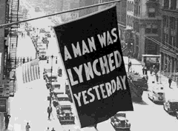
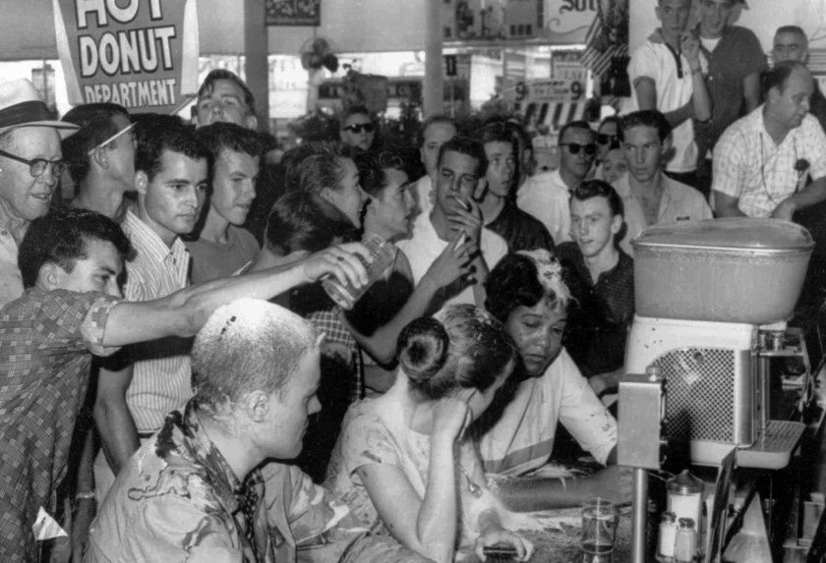
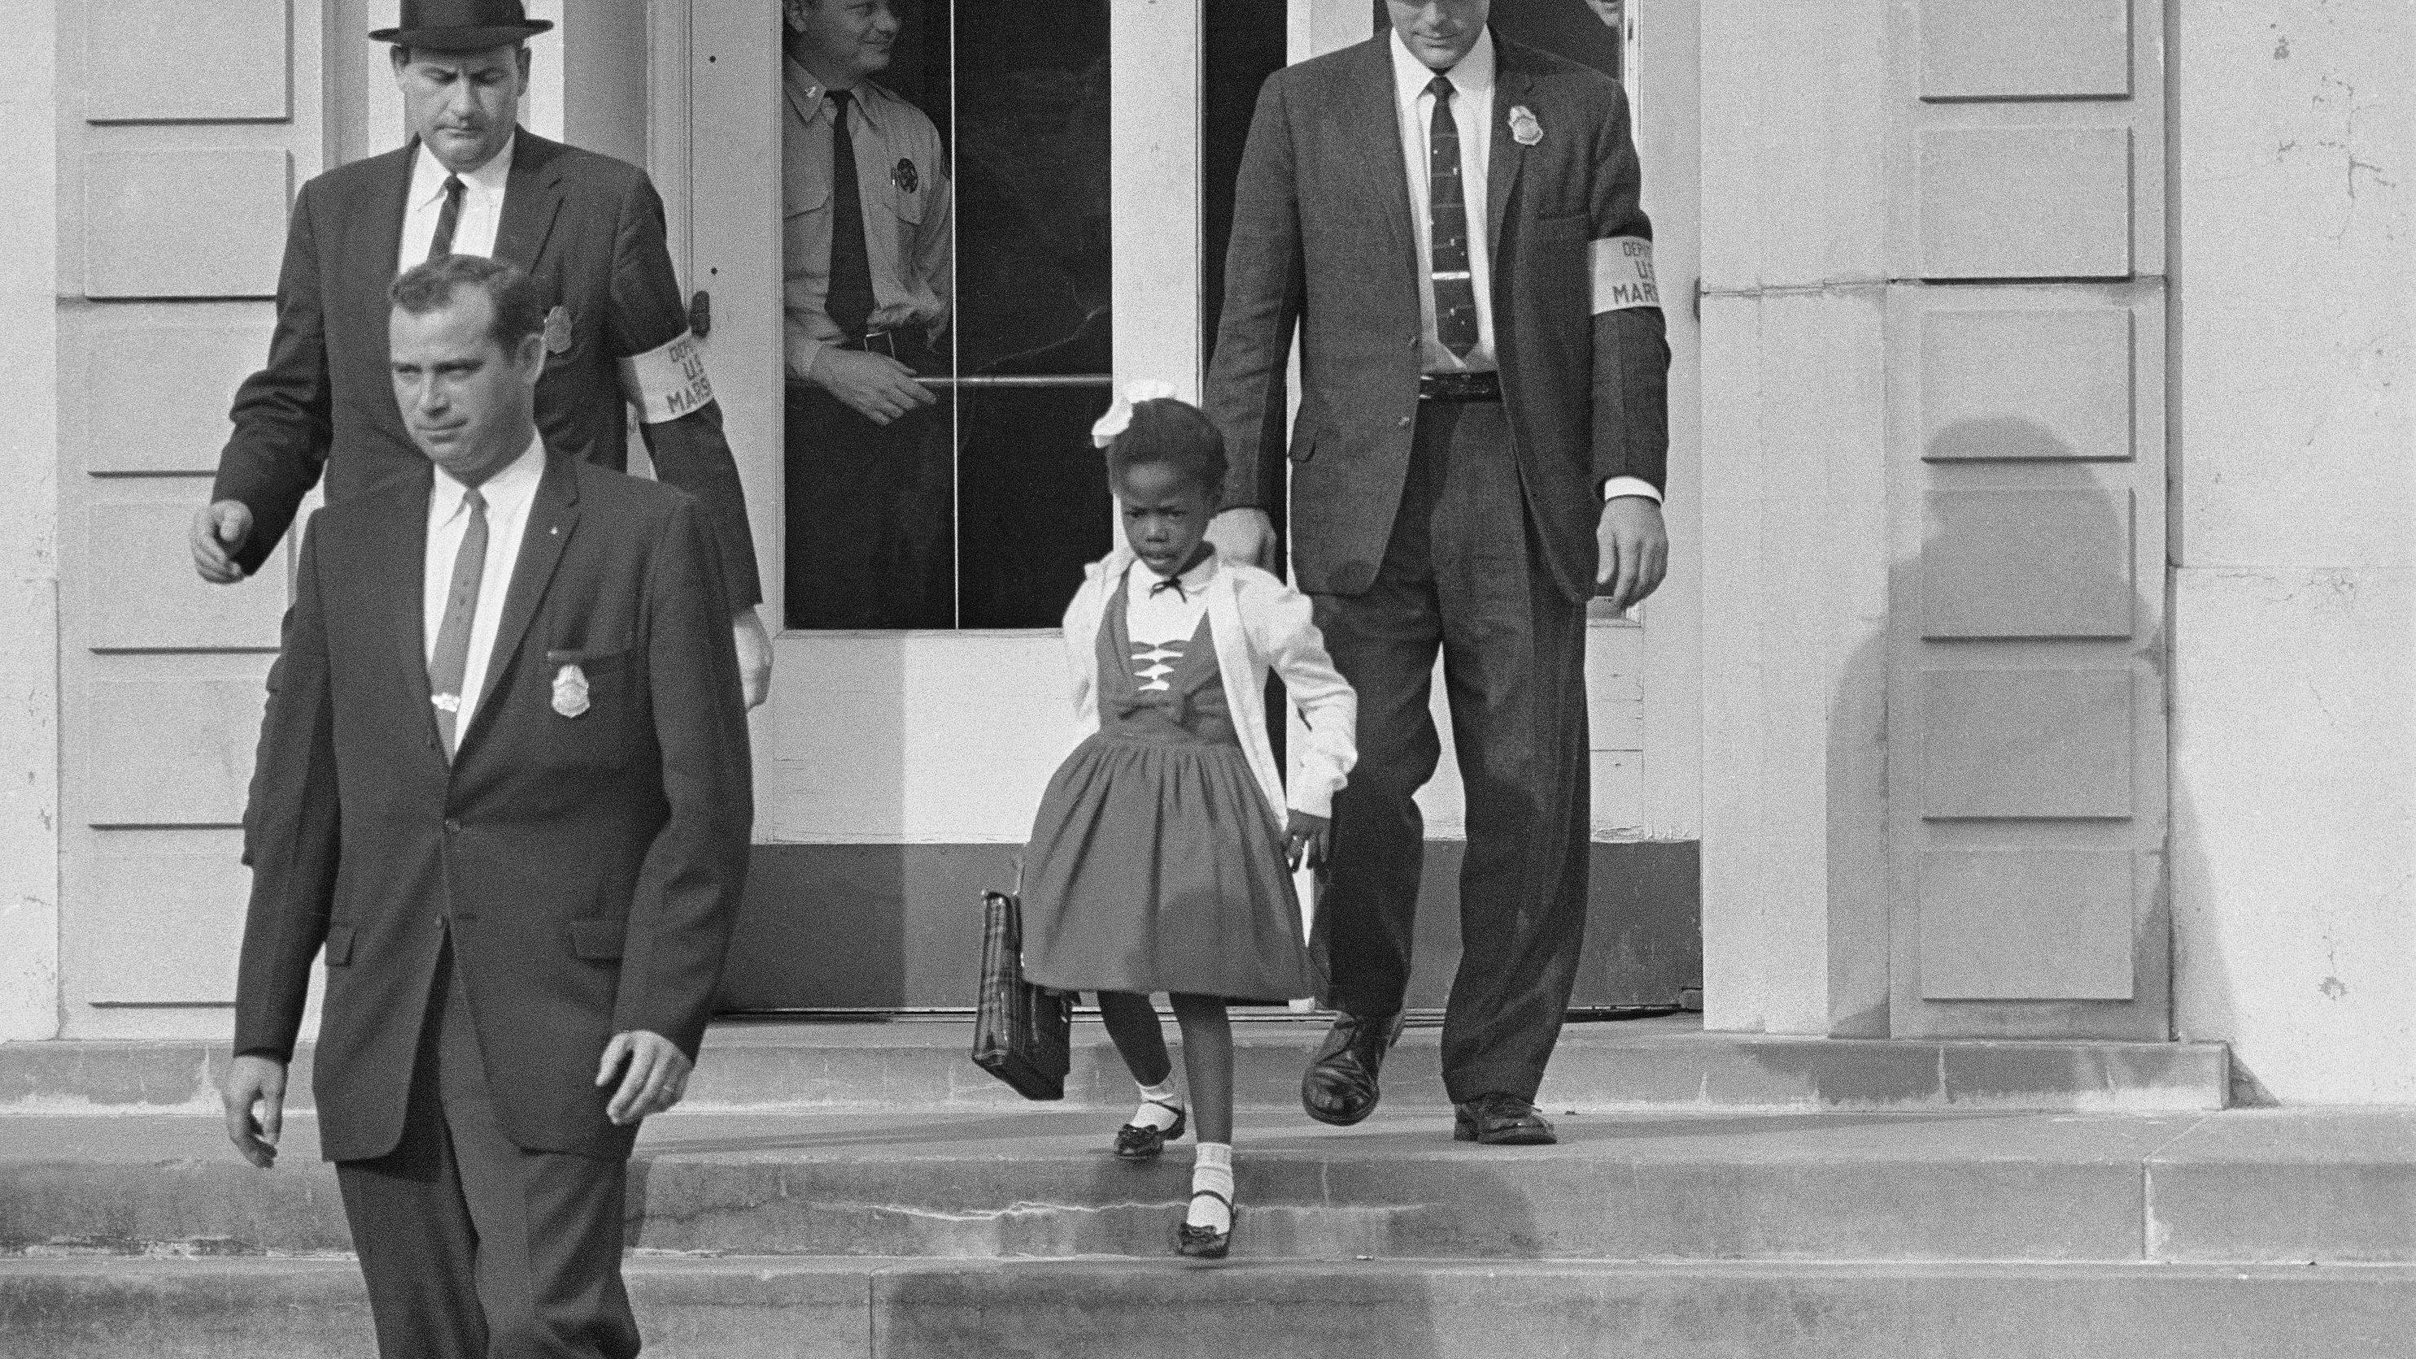
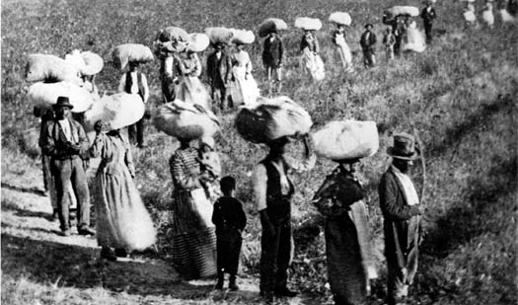
Life for me ain’t been no crystal stair
Notes:
"So you mean to tell me that someone down your ancestry line survived being chained to other human bodies for several months in the bottom of a disease-infested ship during the Middle Passage, lost their language, customs and traditions, picked up the English language as best they could while working free of charge from sun up to sun down as they watched babies sold from out of their arms and women raped by ruthless slave owners. . Took names with no last names, no birth certificates, no heritage of any kind, braved the Underground Railroad, survived the Civil War to enter into sharecropping... Learned to read and write out of sheer will and determination, faced the burning crosses of the KKK, everted their eyes at the black bodies swinging from ropes hung on trees... Fought in World Wars as soldiers only to return to America as boys, marched in Birmingham, hosed in Selma, jailed in Wilmington, assassinated in Memphis, segregated in the South, ghettoed in the North, ignored in history books, stereotyped in Hollywood... and in spite of it all, someone in your family line endured every era to make sure you would get here, but you receive one rejection, face one obstacle, lose one friend, get overlooked, and you want to quit? .
How dare you entertain the very thought of quitting. People, you will never know survived from generation to generation so you could succeed. Don’t you dare let them down! It is NOT in our DNA to quit!"
Post from @solomon.m.kassa
https://www.nbcnews.com/think/opinion/segregation-alive-well-america-s-so-called-land-opportunity-just-ncna873556
https://www.researchgate.net/figure/Slaves-working-in-the-field_fig5_329454180
Memory.loc.gov
Inauguration photo uploaded by: The Obama White House, Jan 20, 2009

Slide 10
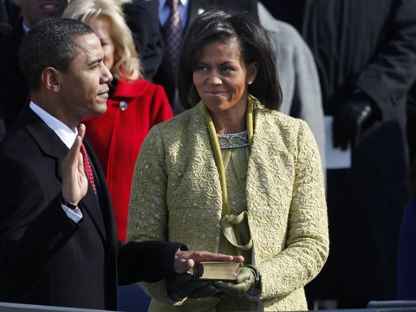
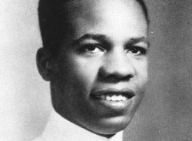
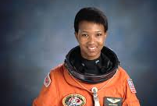
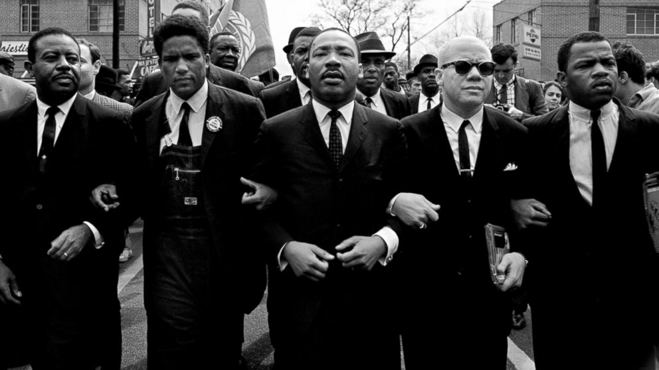
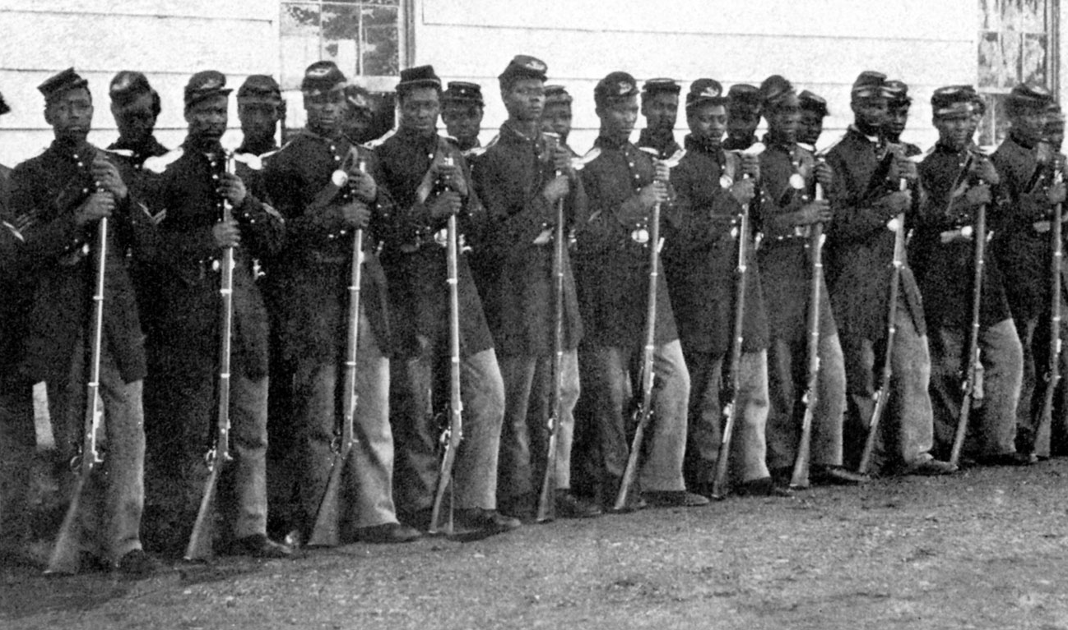
…but…I’se still climbin’
Notes:
"So you mean to tell me that someone down your ancestry line survived being chained to other human bodies for several months in the bottom of a disease-infested ship during the Middle Passage, lost their language, customs and traditions, picked up the English language as best they could while working free of charge from sun up to sun down as they watched babies sold from out of their arms and women raped by ruthless slave owners. . Took names with no last names, no birth certificates, no heritage of any kind, braved the Underground Railroad, survived the Civil War to enter into sharecropping... Learned to read and write out of sheer will and determination, faced the burning crosses of the KKK, everted their eyes at the black bodies swinging from ropes hung on trees... Fought in World Wars as soldiers only to return to America as boys, marched in Birmingham, hosed in Selma, jailed in Wilmington, assassinated in Memphis, segregated in the South, ghettoed in the North, ignored in history books, stereotyped in Hollywood... and in spite of it all, someone in your family line endured every era to make sure you would get here, but you receive one rejection, face one obstacle, lose one friend, get overlooked, and you want to quit? .
How dare you entertain the very thought of quitting. People, you will never know survived from generation to generation so you could succeed. Don’t you dare let them down! It is NOT in our DNA to quit!"
Post from @solomon.m.kassa
https://www.researchgate.net/figure/Slaves-working-in-the-field_fig5_329454180
Memory.loc.gov
Inauguration photo uploaded by: The Obama White House, Jan 20, 2009

