Slide 1
NNOA Conference July 2017
Officer Misconduct and Promotions
MajGen J. R. Ewers Jr.
Staff Judge Advocate
to the Commandant of the Marine Corps

Slide 2
Officer Misconduct & Promotions
Agenda:
Type and frequency of officer misconduct
Officer misconduct process
Officer promotion process following misconduct

Slide 3
PURPOSE (THEME)
Tools for leading officers through the misconduct/promotion process.

Slide 4
Officer Misconduct
Why do we track officer misconduct cases?
To ensure:
Consistent case disposition and treatment of officers across the Marine Corps
Accountability
Retention and Promotion of “fully qualified”

Slide 5
What Gets Reported?
Allegations that an officer committed misconduct for which NJP, court-martial, civilian prosecution, or a separation recommendation is possible . . .
Not speeding tickets, but:
DUI, or arrest by civilian law enforcement;
Orders violations or dereliction of duty;
Hazing;
Sexual harassment;
... Up to and including sex assault or murder
Notes:
If the misconduct is serious enough for a formal counseling, NJP, etc., then it needs to be reported to HQ. We recognize this is a low threshold—it’s supposed to be.
When you’re not sure whether an instance of misconduct should be formally reported, call your SJA for guidance.

Slide 6
Who Makes the Report and When?
Unit COs and Law Enforcement push info to SJA
Commanding Generals, via SJAs, report to CMC immediately upon receipt of credible report of misconduct
Officer Disciplinary Notebook (ODN)
Officer legal/promotion hold
GO’s handle officer misconduct cases

Slide 7
Officer Misconduct Repercussions
Promotions
Career Designation
School / Command assignments
PCS / PCA moves
Deployments
EAS dates
Retirement dates
Advanced Education Assistance repayment
Ability to obtain Reserve commission

Slide 8
Opened Officer Misconduct – Substantiated Cases
(As Percentage of Total Officer Corps)
Over the last 10 years, USMC officers on the ODN comprised an average of 0.64% of the entire USMC officer corps.

Slide 9
Opened Officer Misconduct Cases by Type
(1 Jan 05 - 1 Jul 17)
Notes:
Snapshot of misconduct cases over past 12.5 years

Slide 10
Opened Marine Officer Cases by Grade
(1 Jun 16 – 31 May 17)
Notes:
Snapshot of cases opened in past year by rank

Slide 11
Most Common Offenses by Grade
(1 Jul 16 – 30 Jun 17)
Notes:
Snapshot of offenses by grade over past year

Slide 12
New and Closed Navy and Marine Cases by Calendar Year
Notes:
Trend lines on cases opened/closed generally align with high optempo in mid-2000s (tough to get a DUI in Iraq) and then the 202k growth (larger officer corps).

Slide 13
Life of an Officer Misconduct Case
Incident
Initial Report
Law Enforcement or Command
ODN
GCMCA
If Unsubstantiated
If Substantiated
Accountability
Formal Counseling
NJP
Court-martial
Notification/Separation
Case Closed
No OMPF entry
No info given to boards
Notes:
If a civilian law enforcement authority or court takes action to hold an officer accountable, instead of or in addition to the GCMCA, then the subsequent processing is identical.

Slide 14
Life of an Officer Misconduct Case
Alternate Show-Cause Authority
GCMCA
Direct Show Cause
Board of Inquiry
No Show Cause
SJA to CMC
Case Closed
Appropriate OMPF entries made;
Legal hold lifted
No Show Cause
DC M&RA
Direct Show Cause
Terminate
Proceedings
Separation
ASN M&RA
Notes:
Any case involving an officer’s separation (following a BOI, or based on a resignation/retirement request) must be forwarded to ASN M&RA for final action.

Slide 15
Life of an Officer Misconduct Case
How long does it take?
Incident, Investigation, Accountability, Show Cause Proceedings (if any)
From incident to SJA to CMC (JPL) receiving a case ≈ 390 days
JPL processing ≈ 30 days
DC, M&RA processing (closing case, or, if separating, forwarding case) ≈ 14 days
ASN (M&RA) processing ≈ 21 days
SJA to CMC
DC M&RA
ASN M&RA
Total average time ≈ 15 months
Notes:
Average days computed from cases completed from August 2016 to August 2017.

Slide 16
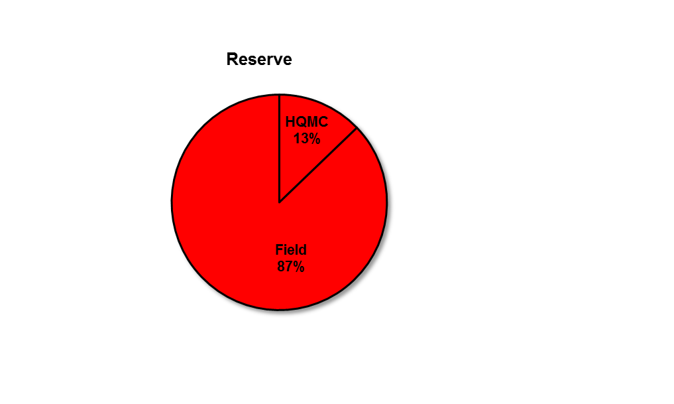
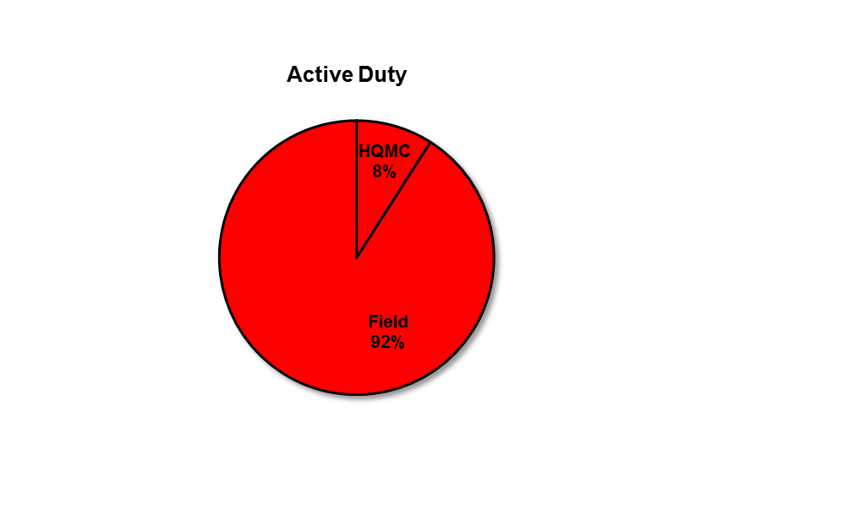
Active Marine Officer Misconduct Cases: Where They Are in the Process as of 31 May 17 220 Active Duty/Reserve
Cases in Field
Active/Reserve
Investigation 61/19
Pre-disposition action 43/6
Awaiting BOI 8/3
Awaiting Military Court 11/0
Awaiting Civilian Court 10/1
Awaiting NJP 3/2
Post-disposition 30/3
Active Duty/Reserve 166/34
Total 200
Cases at HQMC
Active/Reserve
JPL 10/4
DC M&RA 3/1
ASN M&RA 2/0
Active Duty/Reserve 15/5
Total 20

Slide 17
Officer Promotions
Certification of Exemplary Conduct:
“All commanding officers and others in authority in the naval service are required to show in themselves a good example of virtue, honor, patriotism, and subordination….”
“Among the best qualified….”
“Mentally, physically, morally,
professionally qualified to perform
the duties of the grade for which
…selected….”
Notes:
How can your officer’s promotion be delayed when their misconduct case has already closed and they’ve been retained?
10 USC 5947 (Exemplary conduct)
10 USC 624 (Secretary of military department shall certify the officer is among the best qualified)
SECNAVINST 1420.B:
“CMC shall supply all pertinent records of each officer to be considered by the board. Such records shall include all documents…that are essential for a fair and substantially accurate and complete portrayal of each officer’s career as of the date the board convenes.”

Slide 18
What’s Adverse?
IG
DCII
JPL
Historical List
(AODN + CODN)
JPL
“Any substantiated adverse finding/conclusion…or other credible information”
JPAS
06 and Below
General
Officers (+)
EEO
JCA
EO
Notes:
DoDI 1320.04 of 3 January 2014:
Adverse Material – “any substantiated adverse finding or conclusion from an officially documented investigation or inquiry or any other credible information of an adverse nature.”
Credible- “Resolved and supported by a preponderance of the evidence.”
Adverse- “To be adverse, the information must be derogatory, unfavorable, or of a nature that reflects clearly unacceptable conduct, integrity, or judgement on the part of the individual.”
Other “Reportable”- Information other than adverse requested to be reported by SASC or any member of the Senate, information related to alleged misconduct or impropriety, which is subject to an on-going investigative administrative, or judicial process (normally open investigation results in delay or withhold, but where resolution not expected within a reasonable time, nomination may be processed with appropriate summary of case), credible information related to an individual’s involvement or affiliation with a significant event that is widely known to the general public or members of Congress that brings discredit or calls into question integrity members of the DoD….”

Slide 19
Screening Process
PROMOTIONS
At least two screens for each promotion:
As soon as board adjourns (“board screens”)
Approximately a month before the promotion MARADMIN is released (“MARADMIN screens”)
OTHER SCREENS
Retirement requests
Active duty to reserve transition
Upon HQMC request
(Top and Intermediate Level Schools, Command, etc. )
Notes:
PROMOTIONS: Third time JPL screens for a promotion is last day of the month before the promotion.
Snapshot:
Currently 133 officers in a promotion delay or withhold status
Of those, 42 cases are currently active- meaning with JPL with all endorsements, with the AMAB, NJAG, or SecNav/OSD/SASC.
- [61 closed since Sept 16] CMC/SecNav/OSD/SASC have rendered final decisions on 27 cases. Another 34 cases have been closed out by the officer EAS'ing
(without transitioning to the RASL) or being separated by ASN.

Slide 20
Promotion Delays and Withholds
PROMOTION BOARD
SCHEDULED PROMOTON DATE
LIST CONFIRMED
MARADMIN PUBLISHED
TIMELINE
WITHHOLD
DELAY
COMMAND DELAY
Pending misconduct case during board: SecNav will likely withhold
Promotion determination will likely take 8-12 months (after close of misconduct case)
Misconduct prior to the release of the MARADMIN: Dir MM will likely delay
Promotion determination will likely take 7 months (after close of misconduct case)
Misconduct after MARADMIN screened
Promotion determination will likely take 7 months (after close of misconduct case)
Notes:
Timing of the misconduct determines which kind of promotion interruption occurs.
If misconduct occurs before the promotion list is confirmed, then withhold.
If misconduct occurs after promotion list is confirmed, then delay.
If misconduct occurs after the MARADMIN is released, then command-initiated delay.
Animation #1- Red box and “withhold” text appears
Officer was selected by the promotion board.
JAD screen revealed that SNO has adverse material or potentially adverse material (active misconduct case) that promotion board may not have viewed.
SECNAV views a summary of the adverse material and decides whether or not to pull the officer’s name from the selection list that goes to SECDEF or SASC for confirmation.
If SECNAV withholds the officer’s name from the promotion list, SNO is given the chance to comment on the basis for the withhold and to submit any other matters for consideration by SECNAV. SNO’s chain of command will endorse SNO’s matters and provide a recommendation regarding whether or not SNO should be promoted.
Resolution of a withheld promotion can take 6-12 months to complete-even longer if it involves a complicated case.
Animation #2-Green box and “delay” text appears
Officer was selected by the promotion board.
Officer’s name was confirmed for promotion by SECDEF or the SASC.
In the screen before the release of the monthly MARADMIN, adverse or potentially adverse material is discovered that the promotion board may not have viewed.
Dir MM decides whether or not to delay SNO’s promotion. If promotion is delayed, SNO is given the chance to comment on the basis for the delay and to submit any other matters for consideration by SECNAV. SNO’s chain of command will endorse SNO’s matters and provide a recommendation regarding whether or not SNO should be promoted.
SECNAVINST 1420.1B, para 23.a says that the CMC or his designee can delay a promotion. Past practice has Dir MM acting as the designee, but we are looking for a designation letter in the files.
Animation #3- Blue box and “Command Delay” text appears
Officer was selected, confirmed and name appeared on the monthly promotion MARADMIN list.
Officer’s CO signs a letter notifying the officer that he has been delayed. The letter provides the basis for the delay gives the officer the opportunity to respond.
Why? Brand new misconduct /overweight/not technically proficient
Call JAMP for the template of the letter.
The same process applies: SNO has chance to submit matters, chain of command provides endorsement/recommendations, SECNAV makes promotion decision.
Delay must occur BEFORE the scheduled date of promotion- or else officer is promoted. If the command does not notify SNO of the delay in writing before the promotion date, the command can try to show that they took some affirmative action to delay before the promotion date, that written notice was impracticable, and that they notified SNO as soon as practicable. If no command action was taken prior to promotion date, you cannot delay retroactively.
Promotion Trends:
For promotion to captain and above - If the promotion board did not see the adverse information (which happens in most withhold cases and virtually every delay case), SNO will most likely be removed in order to allow a future promotion board to review the adverse information.
For promotion to first lieutenant – There is no promotion board since this is a time-in-grade promotion. Accordingly, removal from the promotion list is not an option and promotion with an adjusted DOR is more likely. Commanders can also recommend that CMC find the officer unqualified for promotion and allow him to reapply (generally after 6 months). Additionally, 21st Century Sailor and Marine guidance does not apply since there is no promotion board involved.

Slide 21
Post-Screen Process
Did the board see the adverse material?
Yes Likely support and report
No
Officer notified CMC considering recommending removal
Withhold/Delay
CMC recommendation (after AMAB)
SECNAV remove or approve (w/ adjusted DoR)

Slide 22
Notice and Comment
Active Misconduct Case
1st opportunity to submit matters (but SNO may defer)
Command endorsements if SNO chooses to submit matters
Closed Misconduct Case
2nd opportunity to submit matters
Command endorsements required even if no matters submitted

Slide 23
Promotions: Adverse Material
Adverse Material Advisory Board (AMAB)
SJA to CMC
Director, Manpower Management
Deputy Commandant,
Manpower and Reserve Affairs
Director, Marine Corps Staff
Assistant Commandant, USMC
CMC
SECNAV
SecDef
President
Senate Armed Services Committee
Notes:
If O6 and below, adverse material usually stops at SecNav. For GO’s adverse material will go all the way to SASC.

Slide 24
Promotions: Adverse Material
SECNAV Options:
Promote with Original Date of Rank
Promote with Adjusted Date of Rank
Remove from Promotion List
SNO competes on next board w/ adverse material in record
Removal = FOS

Slide 25
Takeaways
Report misconduct immediately
Push to resolution
Early reporting helps your officer!

Slide 26
Law Education Programs
Notes:
Snapshot: Over 40% of current JA Colonels came through the Law Education Programs

Slide 27
LAW EDUCATION PROGRAMS
Funded Law
USMC funds tuition, book stipend, bar prep
Full pay and allowances
Excess Leave (Law)
Officer funds tuition and associated costs
Pay and allowances on days not in class
Maintain all other benefits and time counts toward retirement

Slide 28
Funded Law Education Program
Requirements (cannot be waived)
Grade of O-1 to O-3
Minimum of 2 years but not more than 6 years total active duty at the time law education begins
Be able to complete 20 years commissioned service by age 55
2 year service obligation for every year spent in the program.
There is no time on station requirement to apply

Slide 29
Excess Leave Law Education Program
Requirements
Grade of O-1 to O-3
Minimum of 2 years but not more than 8 years total commissioned service (active and reserve) at the time law education begins
Be able to complete 20 years commissioned service by age 55
1 year service obligation for every year spent in the program
There is no time on station requirement to apply

Slide 30
What next?
Review MCO P5800.16A (Chapter 19)
Study for and take LSAT
Apply to law schools
Watch for annual MARADMIN
Board meets during November

Slide 31
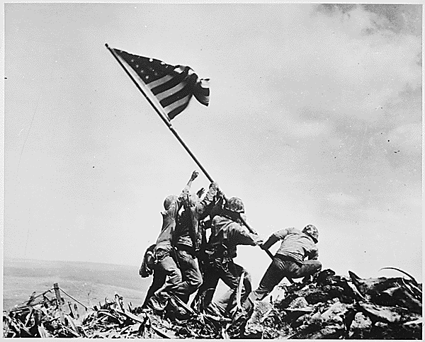
Questions?

