Slide 1

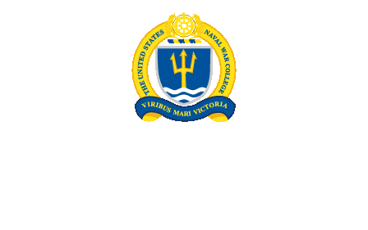
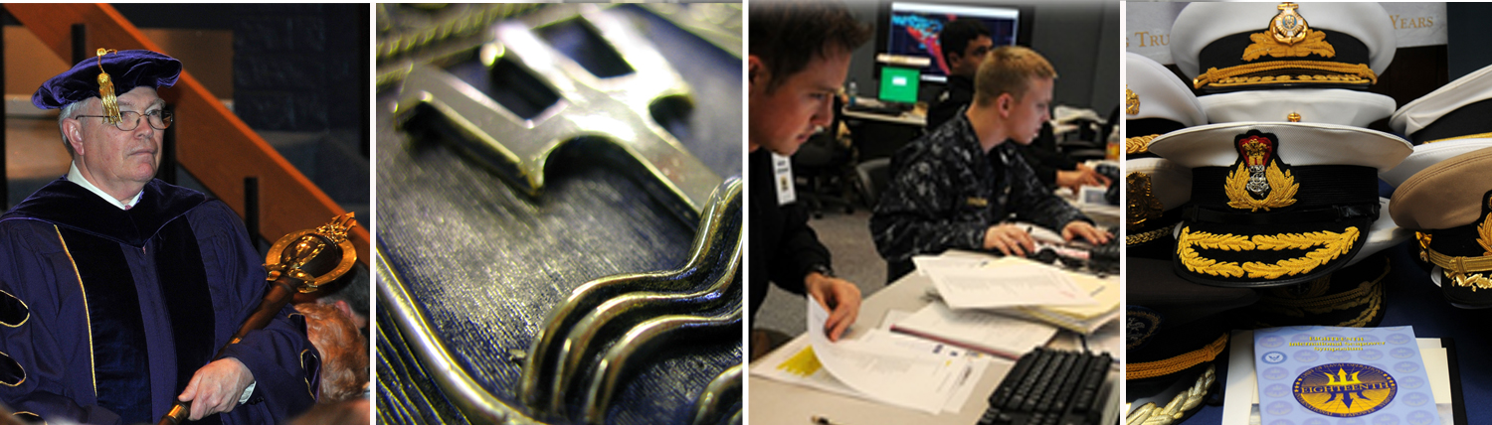
A Professional Military Education Institution
Post-Graduate Education and Professional Development
NNOA - 27 July 2017

Slide 2
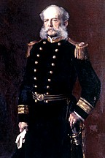
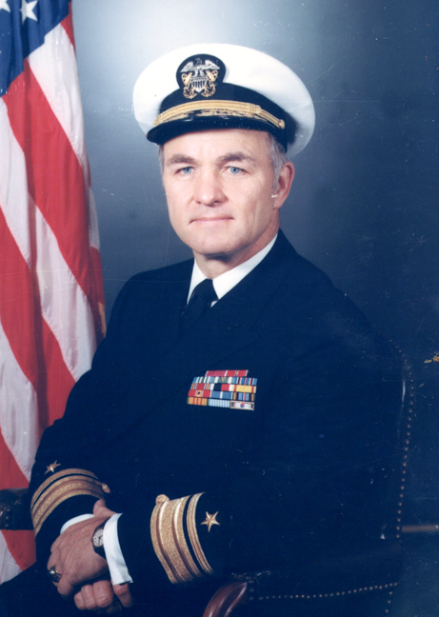
“[The War College] is a place of original research on all questions relating to war and to statesmanship connected with war, or the prevention of war.”
RADM STEPHEN B. LUCE, USN
Founding President, NWC
“Any new improvement in the College’s courses of instruction must support the objective of the Naval War College, which is to enhance the capability of naval officers to make sound decisions in both command and management positions.
To do this the College will emphasize intellectual
development and academic excellence.”
VADM STANSFIELD TURNER, USN President, NWC, 1972
Notes:
USNWC functions today under strategic tradition established by our founder, RADM Stephen B. Luce, as a professional education institution. The professional body of knowledge to be studied and matured was the study of war and its prevention. He believed the technical demands of a steam-driven Navy were too narrowly focusing the efforts of the naval profession. RADM Luce envisioned that the Naval War College would ensure that naval officers remain engaged as professionals on the principal element of the profession—the study of war, including the strategic issues affecting the nation’s security and the means to prevent or, if necessary, win wars.
- In 1972, as the Navy and the nation were grappling with the lessons of Vietnam, VADM Stansfield Turner transformed the College’s educational methodology by establishing the system we continue to use today. He emphasized professional military education that improved critical thinking and led to better decision making. Based on his own experience at Oxford, he created a trimester system with three interdisciplinary, core departments and a mixed faculty of successful academics and military professionals. They developed curricula designed to study warfare and the responsibilities of the military profession delivered through a seminar-based, graduate-level academic program that required them to read, study, and interact with their peers.
- Today’s complex and uncertain world demands the strategically-minded, critical thinking students the Naval War educates.

Slide 3
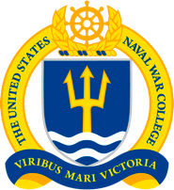
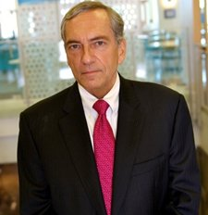
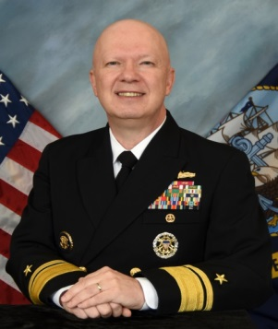
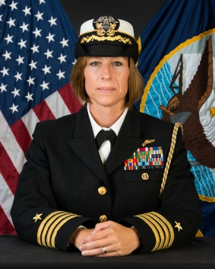
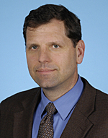
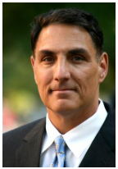
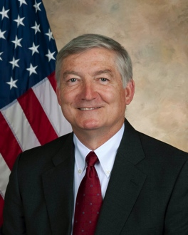

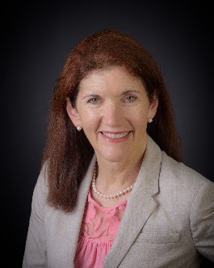

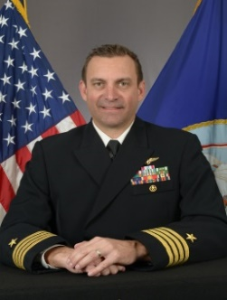
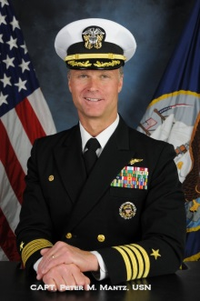
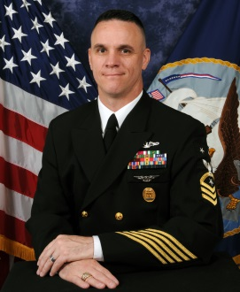
Senior Leadership
Prof. Lewis Duncan, PhD
Provost and
Dean of Faculty
Rear Admiral
Jeff Harley
President
Naval War College
Captain Tamara Graham
Vice President/Chief of Staff
Dr. Phil Haun
Dean
Academics
Prof. Thomas Culora
Dean
Center for Naval Warfare Studies
Prof. James Kelly
Dean
College of Maritime Operational and Warfare
Prof. Tom Mangold
Dean
International Programs
Prof. Margaret Klein
Dean
Leadership and Ethics
Prof. Walt Wildemann
Dean
College of Distance Education
Captain Patrick Keyes
Dean of Students
Captain Peter Mantz
CO, NLEC
CMDCM Richard Curtis
Director
Senior Enlisted Academy

Slide 4
War College Vision
President’s Lines of Operations
  Operationalize
  Navalize
  Futurize
  Internationalize
  Normalize

Slide 5
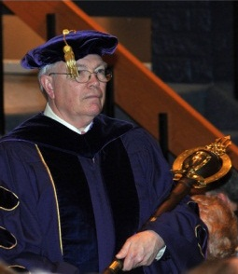

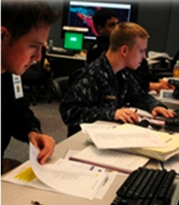
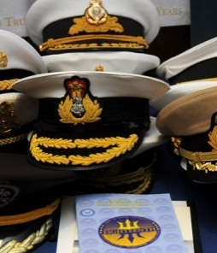
The College’s Missions
  Educate and Develop Future Leaders
  Support Defining the Future Navy and Associated Roles and Missions
  Support Combat Readiness
  Strengthen Global Maritime Partnerships
  Promote Ethics and Leadership
  Contribute Knowledge through Maritime History Center expertise
  Provide Expertise and Advice to International Legal Community
Notes:
Today, the College formally has four mission functions; we began operating with these four functions in 2003. Everything the College does contributes, in the larger sense, to educating and developing leaders. Every aspect of our activities relates to the study of war or its prevention. Faculty share their knowledge and insights in a number of venues and challenge our students and our participants to hone their skills of abstraction, analysis, and decision making required of higher-level staff and command.
The College’s formal mission provides these four principal mission functions. The first two functions have been integral to the College since its earliest days. What has changed is that the College is now responsible for professional military education, naval and joint, to officers and enlisted Sailors throughout their length of service.
And the College has long been engaged with military professionals from other nations; after the Second World War, ADM Spruance formally extended the educational mission to incorporate naval officers from allied or friendly navies. Since 2001, the significance of partner nations has taken on a new dimension and this heightened importance raised the mission task to the level of a mission function.
During the last decade, the College has reconnected directly to the fleet with its responsibility for operational level of war education. This formal reconnection is the most significant change and rests on the College’s expertise in the operational level of war.

Slide 6
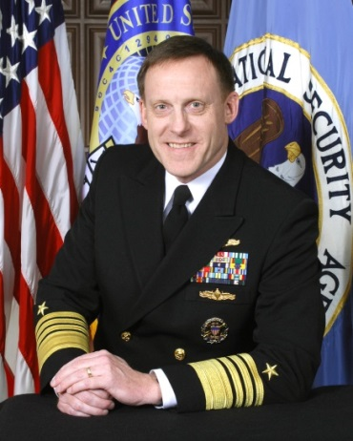
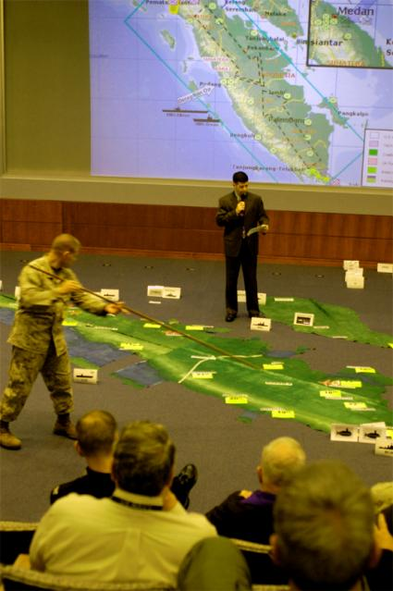
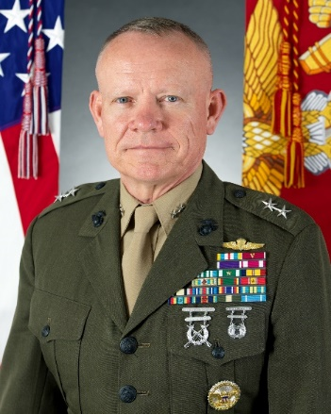
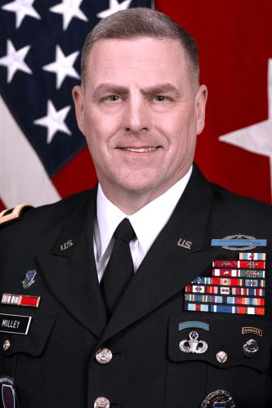
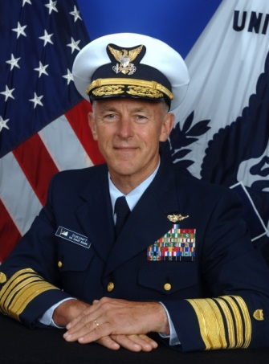

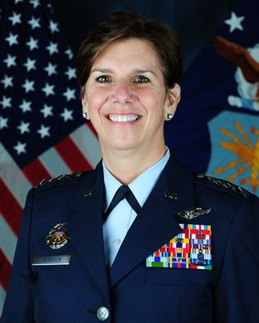
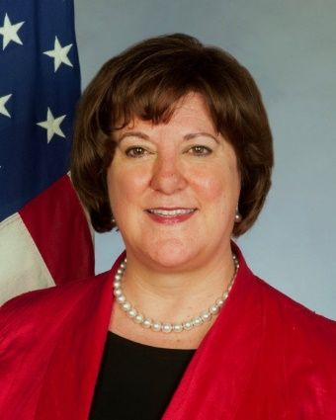
Mission Area One
Educate and Develop Future Leaders
Notes:
- The College’s tradition of educating key leadership has expanded well beyond the Navy to include extraordinary leaders across the military Services and other federal agencies.
- This slide shows a few of our alumni now serving in key leadership positions:
(viewer’s perspective—from upper left)
ADM Michael S. Rogers, Commander, U.S. Cyber Command, Director, National Security
Agency, Chief, Central Security Service
LtGen Lawrence D. Nicholson, Commander, III MEF, MARFOR Japan
GEN Mark Milley, Chief of Staff, US Army
ADM Paul Zukunft, Commandant, US Coast Guard
GEN Lori Robinson Commander, Northern Command
AMB Mary Beth Leonard, U. S. Ambassador to the African Unions
.

Slide 7
The Navy’s PME Continuum
O-1 to O-3
O-3 to O-4
O-5 to O-6
O-7
O-8
O-9
ASP
JFOWC
ASP
RESIDENT
JFACC
JFLCC
JFMCC
MAWS
CAPSTONE
PINNACLE
SEA
SENIOR
JPME Phase II
Updated 7/17
RESIDENT
INTERMEDIATE
JPME Phase I
(Restructured
Aug 06)
PRECOM
(Restructured
Aug 06)
CMDCM
PRIMARY
PME
BLENDED
KEYSTONE
NON-RESIDENT
- Fleet Seminar
- NWC-at-NPS
- Web-enabled
- CDROM-based
(Fielded
May 06)
Updated 7/17
BASIC
DL via NKO
DL via NKO
Updated 7/17
INTRO
Career-long educational opportunities related to mission, supporting
professional and personal growth of all Sailors, officers and enlisted.
DL via NKO
E-1 to E-4
E-4 to E-6
E-7 to E-8
E-8
E-8 to E-9
E-9 Navy Executive
E-9 Joint Executive
Notes:
Shows range of USNWC responsibilities :
From introductory Enlisted Professional Military Education (On “Navy Knowledge On-line”)
To Flag level courses such as the Joint Force Maritime Component Commander’s course.
In the center of the slide:
- Intermediate level Joint Professional Military Education program and our Senior Level Program.
- Content of these courses is designed and developed by our faculty,
- Must meet the standards established by the Chairman of the Joint Chiefs of Staff.
Regularly visited by the CJCJ Accreditation Team -- Process for Accreditation of Joint Education (called PAJE)
Also subject to accreditation visits by the New England Association of Schools and Colleges (NEASC) which enables us to award our fully accredited Master of Arts in National Security and Strategic Studies degree.
Take Away: We embrace joint requirements and embed them into our PME

Slide 8

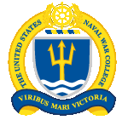
    Who We Are – Our Resident Students
U.S. Military Leaders & Key Federal Employees:
College of Naval Warfare (CNW) 156 Students
College of Naval Command and Staff (CNC&S) 279 Students
International Officers:
Naval Command College (NCC) 48 Students
Naval Staff College (NSC) 58 Students
Other Resident programs:
Flag Level Education – Joint Forces Maritime Component Commanders Course (JFMCC) 24 Students
Executive-level OLW Course (ELOC) 75-100 Students
Maritime Operational Planners Course (MOPC) 72 Students
Maritime Staff Operators Course (MSOC) 400 Students
Senior Enlisted Academy (SEA) 1100 Students
8
Notes:
We operate 10 resident programs in Newport, and another 10 non-resident programs around the country and in cyber-space.
- Two levels of education:
- Intermediate level for mid-grade officers (Junior course) = 281 students
- Senior Service-College Level (our senior course). = 206 students
- Three “international colleges” :
- Naval Command College for senior officers = 46 students
- Two intermediate-level programs in the Naval Staff College = 85 students.
OTHER RESIDENT PROGRAMS:
Flag level courses JFMCC = 30 students
Senior Enlisted Academy = 784 students
Maritime Staff Operators Course (MSOC) = 400 students

Slide 9
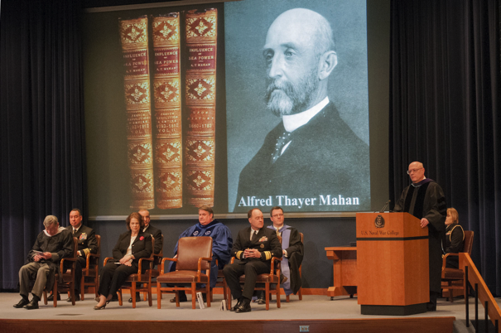
Two Graduate Programs
Senior-level Course
  Joint Professional Military Education Phase II
  M.A. in National Security and Strategic Studies
Intermediate-level Course
  Joint Professional Military Education Phase I
  M.A. in Defense and Strategic Studies
  Basis of non-resident JPME I course
Notes:
- The Naval War College is unique among PME institutions in that one faculty teaches both JPME I and JPME II at a graduate-degree level. Although this places inordinate demands on faculty workload, it permits coordinated evolution of each program as well as greater interaction between intermediate- and senior-level students where appropriate.
- Per authorization from the New England Association of Schools and Colleges (NEASC), the NWC was authorized to grant two separate Master of Art degrees based on the significant differentiation of the Nimitz Course (JPME II) and the Spruance Course (JPME I). These two degrees went into effect at the beginning of the current Academic Year.

Slide 10
Senior-level Course
JOINT
MILITARY
OPERATIONS
NATIONAL
SECURITY
DECISION MAKING
STRATEGY
&
POLICY
AUG
SEP
OCT
NOV
DEC
JAN
FEB
MAR
APR
MAY
JUN
JUL
ELECTIVE - ARP
ELECTIVE - ARP
ELECTIVE - ARP
THEATER
SECURITY
DECISION MAKING
JOINT MARITIME
OPERATIONS
STRATEGY & WAR
Intermediate-level Course
Taught by one faculty (unique in all PME)
Interdisciplinary and modular—permits phased inputs
Senior and Intermediate students mix in 100+ Electives
Integrated with two 13-month programs:
  Advanced Strategist Program (ASP)
  Maritime Advanced Warfighting School (MAWS)
Notes:
- The Nimitz Course and the Spruance Course are each divided into three trimesters, and each trimester is taught by one of the three Core Departments: Joint Military Operations, National Security Affairs, and Strategy and Policy. The core curriculum equips all students to formulate, investigate, and evaluate approaches to operations and strategy. They practice operational art and design at the Joint Task Force and Combatant Command levels via intensive seminars, presentations, and capstone exercises. They critically examine contemporary national and military strategies, campaigns, and operations. Then, they are required to develop national and military strategies, operational and campaign plans, theater security plans, and force development options with relevant political and budgetary strategies. They test these products against representatives from Combatant Commands, policy makers, and think tank experts as well as against their joint, interagency and international peers. Students also utilize case studies and classical military theory to examine innovative strategies and policies in the laboratory of history in order to generate novel, forward-thinking approaches to contemporary security issues.
- Unlike other PME institutions that matriculate all of their students in August, the NWC permits “phased input” students to matriculate in August, November, and February for a year-long program. This is of particular benefit to the Navy since it multiplies the flexibility of assigning students to in-resident JPME I and/or JPME II. This is made possible by a curriculum that is modular and not additive. Students may begin at different times of the year at the beginning of a trimester and, over the course of the next 10-12 months, acquire essentially the same educational experience as students who matriculate in August. Overall, the NWC’s unique trimester system and phased input of students throughout the academic year allows for constant acculturation and peer mentoring across cohorts. Electives and Special programs mix Intermediate- and Senior-level students to improve mentoring, socialization, and networking.
- The Maritime Advanced Warfighting School (MAWS) and the Advanced Naval Strategist Program (ANSP) conduct summer studies and amount to 13-month programs. MAWS performs a capstone project and brief, most recently to PACFLT. Notably, MAWS recently expanded (per OPNAV request) from two to three seminars and now has 44 students. ANSP began in 2013 and constitutes a single seminar of students who do a deeper dive into various issues of strategic studies to include the economic foundations and geopolitics of strategy. ANSP, moreover, is the only academic program at the NWC that requires a thesis.

Slide 11
Senior-level PME Outcomes
Skilled in Formulating and Executing Strategy and U.S. Policy
Skilled in Joint Warfighting, Theater Strategy, and Campaign Planning
Capable of Strategically-minded, Critical Thinking
Capable of Excelling in Positions of Strategic Leadership
Strategically minded, critically thinking leaders
who are skilled in maritime and joint warfighting
Notes:
The VCNO CORPORATE BOARD approved these outcomes for the graduates of the College of Naval Warfare on 4 May 2005. The more detailed version of these outcomes is contained in the academic brief. They include the Navy and Joint requirements for JPME Phase II. Clearly, the focus of this course is to prepare students to contribute to national security issues at the strategic level. Joint warfighting is a secondary emphasis of the course focused at the national and theater levels.

Slide 12
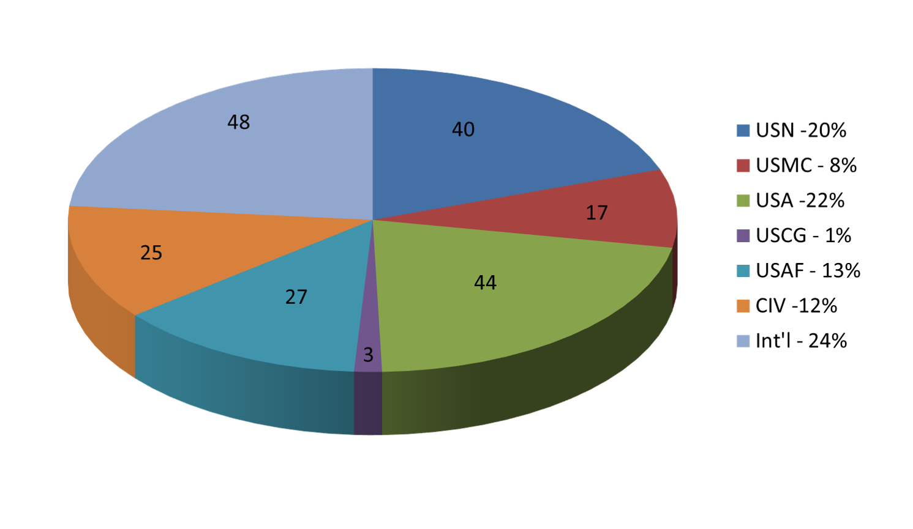
Senior-level Course
February 2017
204 Students

Slide 13
Intermediate-level PME Outcomes
Skilled in applying OPERATIONAL ART to Maritime, Joint, Interagency, and Multinational Warfighting
Skilled in Joint/Navy Planning Processes
Capable of Critical Thought with Operational Perspectives
Prepared for Operational Level Leadership Challenges
Effective Maritime Spokespersons
Critically thinking planners and leaders
with a maritime, operational-level perspective
Notes:
The VCNO CORPORATE BOARD approved these outcomes for the graduates of the College of Naval Command and Staff on 4 May 2005. The more detailed version of these outcomes is contained in the academic brief. They include the Navy and Joint requirements for JPME Phase I. Clearly, the focus of this course is to prepare students to contribute to maritime and joint warfighting at the operational and theater-strategic levels of war. Building operational level of war and planning expertise was deemed a critical need for the Navy. National security issues involving military power is a secondary emphasis of the course focused at the theater-strategic level.

Slide 14
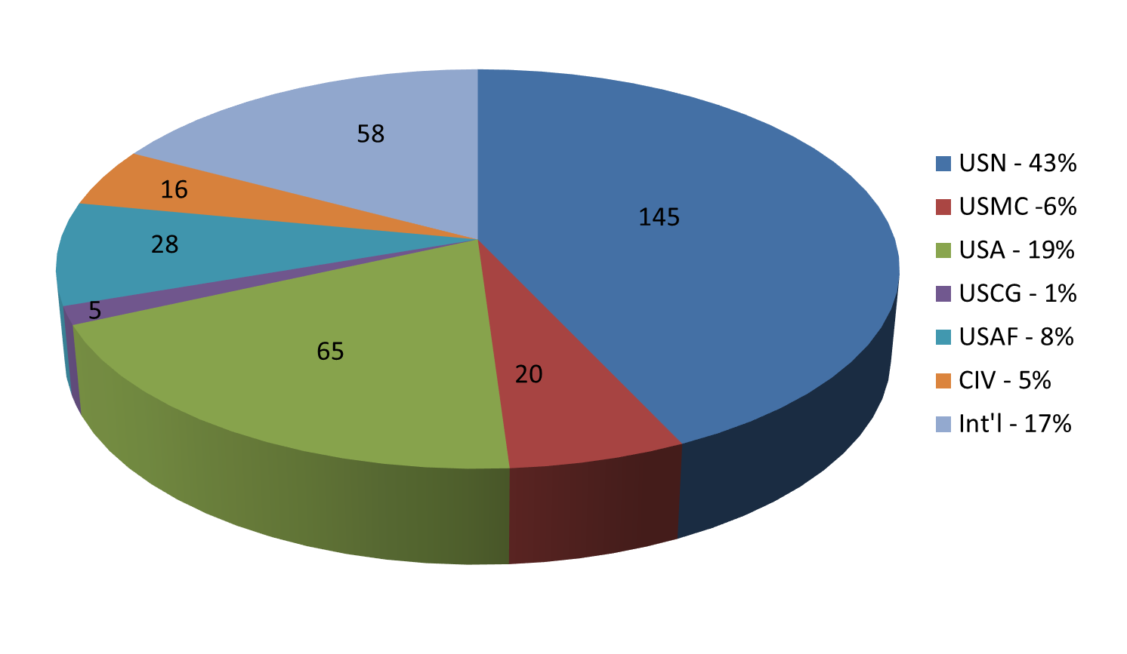
Intermediate-level Course
February 2017
337 Students

Slide 15
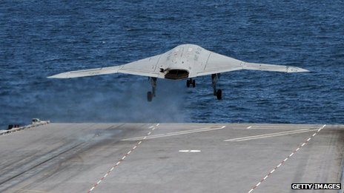
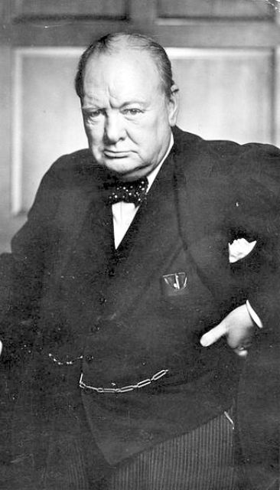

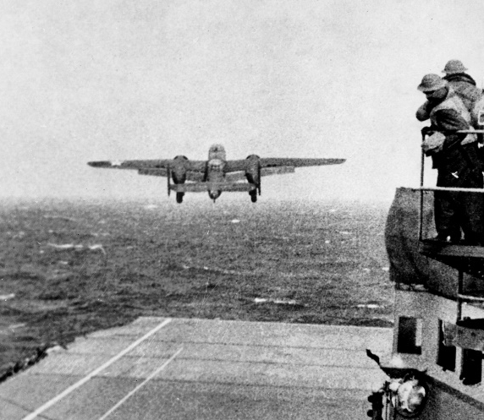
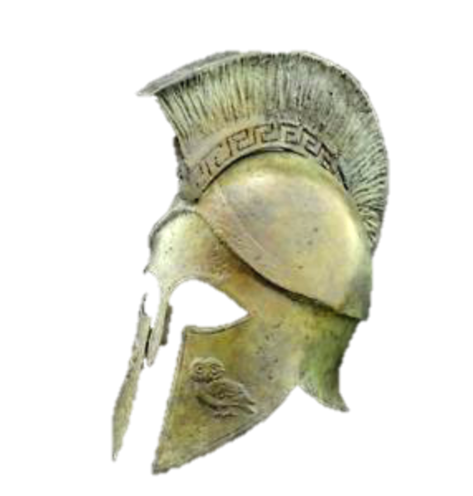
Electives
100+ Electives mix senior and intermediate students
20 Areas of Study (some earn designators)
Taught by faculty throughout NWC plus adjuncts
The empires of the future are the empires of the mind.
(Churchill, 1943)
Notes:
- The Electives program allows for concentrated focus for specific areas of interest or for future assignments. The program includes over 100 separate courses. Examples: “Modern China;” “Winston Churchill: Statesman and War Leader;” “The American Revolutionary War;” “Ethics and Technology;” “Information Operations and Cyberwarfare (TS/SCI);” “Unmanned Systems and Conflict in the 21st Century;” “Chinese Intelligence Systems and Practice;” “Foundations of Moral Obligation;” “Women in Combat and War;” and “Strategy, Leadership, and Ethics in Thucydides’ Peloponnesian War.” Given the large number of individual courses, the Electives Program is organized into Areas of Study, some of which offer an AQD if the student takes all three Elective trimesters in the same Area of Study.
The Areas of Study include:
Regional and Cultural (AQD in each): Middle East, Asia-Pacific, Latin America, Europe-Russia, Africa, Arctic (no AQD)
Executive Analysis for the Commander (AQD)
Operational Law (AQD)
Information Operations (AQD)
Irregular Warfare (AQD)
Homeland Security and Homeland Defense (AQD)
Corporate & Enterprise Strategic Planning (AQD)
Strategy, Operations, and Military History
Leadership and Ethics
Research Projects
- The NWC also offers several group-based Elective programs and Advanced Research Projects:
Joint Land, Air, & Sea Strategic Exercise (JLASS-EX) (AQD)
Advanced Naval Strategist Program (ANSP)
Maritime Advanced Warfare School (MAWS) (AQD)
Group Advanced Research Projects
Mahan (STRATCOM and deterrence/proliferation)
Gravely (IADs, missile defense, undersea warfare)
Halsey Alpha (PACOM challenges)
Halsey Bravo (CENTCOM challenges)

Slide 16
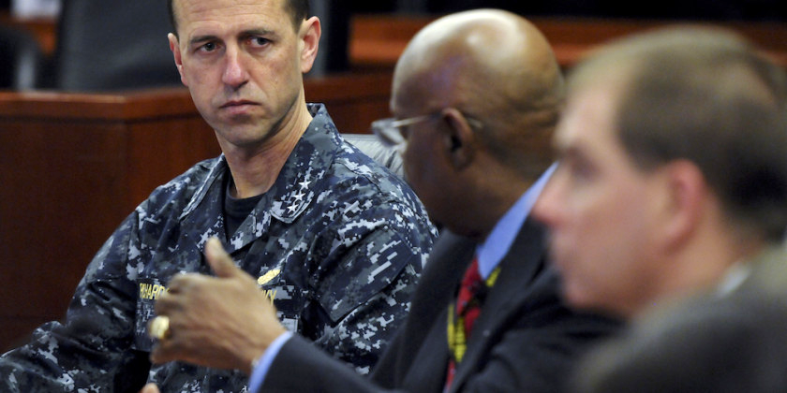
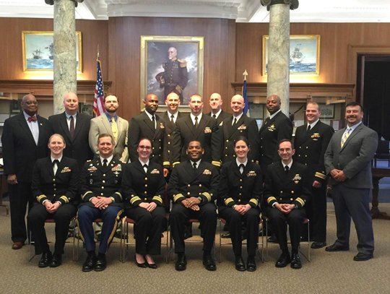
Advanced Research Programs
Year-long Electives
Halsey Alfa
Halsey Bravo
  Continuous AOR focused war gaming at the operational and detailed tactical level
Gravely Group
  Individual and group research on leading edge technology and operational concepts
Mahan Scholars
  Strategy and Strategic Deterrence

Slide 17
    College of Distance Education
Intermediate-level College Enrollment (AY 2016 – 2017)
  Fleet Seminar Program 917 Students
  Graduate Degree Program ~600 Students
  NWC-at-NPS Program 1640 Students
  Web-enabled Program 1440 Students
  CDROM-based Program 540 Students
Navy Knowledge Online (NKO) Enrollment (1 July 2017)
  Total PME via NKO 277930 Students
  Graduates 100420
17
Notes:
The Intermediate Level College offers JPME I opportunities to non-resident students. The essential program is parallel to and derived from Newport’s in-resident ILC program (the Spruance Course). Thus, changes to the resident course are manifested in subsequent iterations of non-resident education. For example, the increased emphasis on incorporating ethics into the in-resident core curriculum will feed into the non-resident curriculum to multiply impact.

Slide 18
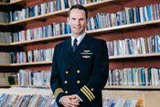
Graduate Education and Graduate Teaching Opportunities
Professional Goal – Graduate Education
  Attend a service intermediate or senior JPME college
  Obtain a Masters Degree and complete Joint Professional Military Education Phases I and II
Permanent Military Professor (PMP) or Military Professor Assignment
  The Permanent Military Professor (PMP) established in 1997 to build a cadre of career naval officers with both doctoral degrees and operational experience who would instruct at one of the Navy's education institutions until statutory retirement or until released from active duty.

Slide 19
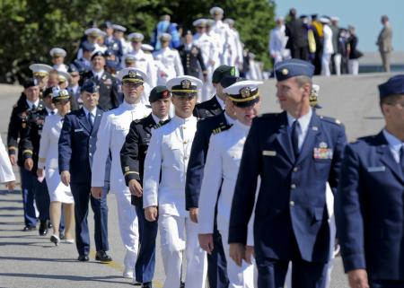
Learning
Life- Long Learning
Formal Education and Training
Practice High-velocity Learning - Unplugged
Participate In War Games and other professional gatherings
Professional Reading
  CNOs Reading List
  USNI Proceedings and News BLOG
  Neptune’s Inferno
  The War Below
  Thank You For Being Late
  Ghost Fleet

Slide 20

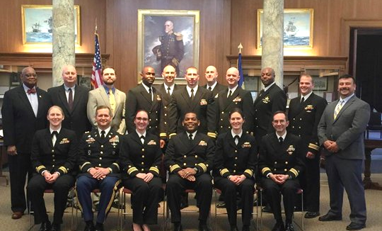
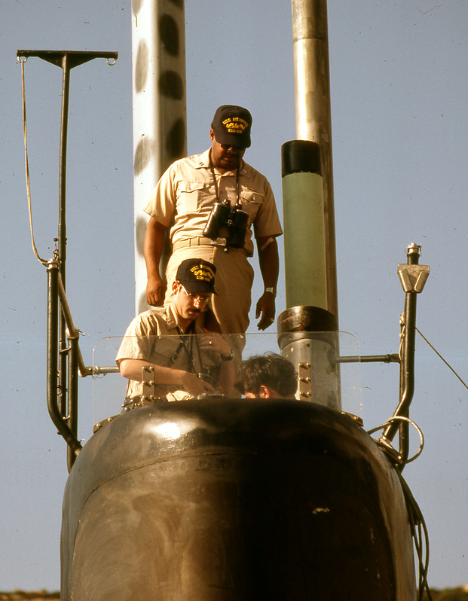
Professional Growth and Academic Advancement
Education + Experience + Creative Freedom

Slide 21

Mission Area Two
Support Defining the Future Navy
Notes:
Support Defining the Future Navy
- The Center for Naval Warfare Studies, like all of the other elements of the College, contributes to the accomplishment of all of the missions of the organization -- Educating Leaders, supporting readiness and engaging with our international partners and allies -- but the “sweet spot” for the Center is in it ability to support defining the Future Navy.
- Through the talents and unique skills of its faculty and staff, coupled with the physical resources of McCarty-Little Hall and other material assets, the Center can apply a wide-range of research methodologies, analytical approaches and war gaming techniques to identify trends, develop ideas and gain an understanding of the future of naval warfare.
- The essential mission of CNWS is “Knowledge Creation” for the Navy.

Slide 22
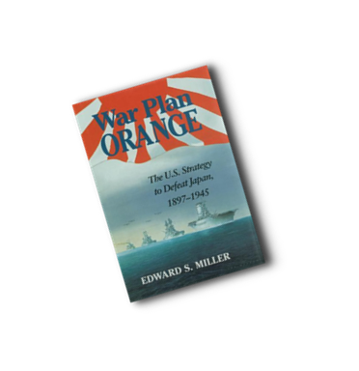
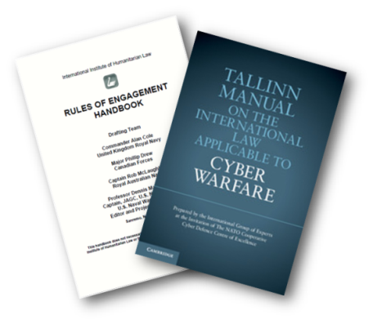
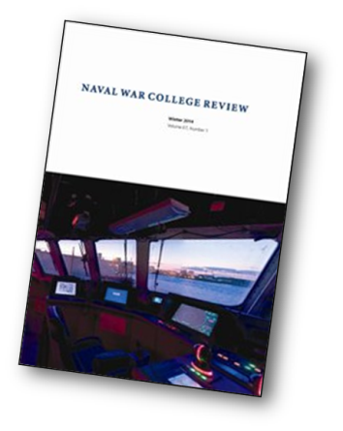

Center for Naval Warfare Studies
WARGAMING
INTERNATIONAL LAW
STOCKTON
CENTER
STRATEGIC & OPERATIONAL
RESEARCH
(SORD)
GLOBAL, Title 10 Series
Fleet Sync Conference
Fleet Games
Relevant COCOM Games
CNO Directed Games
Games supporting JPME
Decision Support
Maritime Law
Law of War
Cyber Law
International Law Fellows
Strategy Development
Regional Expertise
Advanced Research Groups
  Halsey Alfa
  Halsey Bravo
  Gravely Group
  Mahan Scholars
Wargaming
Virtual Community
of Practice
Center for Cyber Conflict Studies (C3S)
NAVAL WAR COLLEGE PRESS
Russia Maritime
Studies Institute
22
UNCLASSIFIED

Slide 23
Advanced Research Groups
Year-long Electives
Halsey Alfa
Halsey Bravo
  Continuous AOR focused war gaming at the operational and detailed tactical level
Gravely Group
  Individual and group research on leading edge technology and operational concepts
Mahan Scholars
  Strategy and Strategic Deterrence

Slide 24
CNWS Key Initiatives
Wargaming Virtual Community of Practice (VCoP).
  Classified and unclassified venues
Russian Maritime Studies Institute (RMSI)
Refocused on Future of Naval Warfare and on US Fleet Architecture/Future Fleet
Designing Study for maritime “Gray Zone Conflict”
Strengthening faculty in China Maritime Studies Institute, RMSI, and Center for Cyber Conflict Studies
Notes:
Expansion of GLOBAL War Game series. The Global Series is the Navy’s Title X War Game conducted at the direction of the Chief of Naval Operations. The effort over the past two years is focused on various war-fighting and engagement issues in order to identify relevant manning, training and equipment (MT&E) implications for the Navy. Utilizing an iterative gaming process, five separate events have been planned and four executed thus far in order to leverage insights and lessons from event to event.
Establishment of permanent SAP wargaming capability at the War College. The CNO provided guidance to the Naval War College that requires the inclusion of more Special Access Program (SAP) information into war games. The War Gaming Department worked internally within the Center's budget to facilitate the modification of Sims Hall to support TS/SCI/SAP war games and also support the Halsey and Mahan Advanced Research Programs. These modifications will provide for a fully operational high classification war gaming facility which will enhance Naval operational planning and decision making.
Establishment of the Wargaming Virtual Community of Practice (VCoP). The Naval War College's Center for Naval Warfare Studies is currently establishing a wargaming virtual community of practice (VCoP), as directed by the Secretary of the Navy in 2015. Specifically, in order to further the Nation's warfighting strategy, the SECNAV memorandum mandated the use of wargaming as a tool to “assess new ideas, question existing practices, stimulate innovation, and develop new operational concepts in a risk-friendly environment.” Given its pedigree as the nation’s leader in maritime war gaming since 1887, the Chief of Naval Operations identified the NWC’s War Gaming Department within CNWS as the appropriate entity to organize and house this VCoP. Once fully established it will facilitate collaboration and accelerate learning throughout the Naval Enterprise. It is intended to compliment and append organizational work being done at the DoD level in wargaming.

Slide 25
CNWS Research Priorities FY 2017 - 2018
GEOGRAPHICAL
FUNCTIONAL
China
  South & East China Sea
  Taiwan
  Silk Road and Belt
Russia
  All Theaters
  Operational & Tactical Warfighting
  Joint & Coalition Warfare
National & Maritime Strategy
Information Warfare (Cyber & Space)
War Gaming Community of Practice
International Law
PRIMARY
KNOWLEDGE CREATION
Iran
Indian Ocean
Korean Peninsula
Deterrence (Nuclear & Conventional)
Gray Zone Conflict
War Escalation & Termination
Maritime History
SECONDARY
Expand Education ACTIVITIES
UNCLASSIFIED

Slide 26
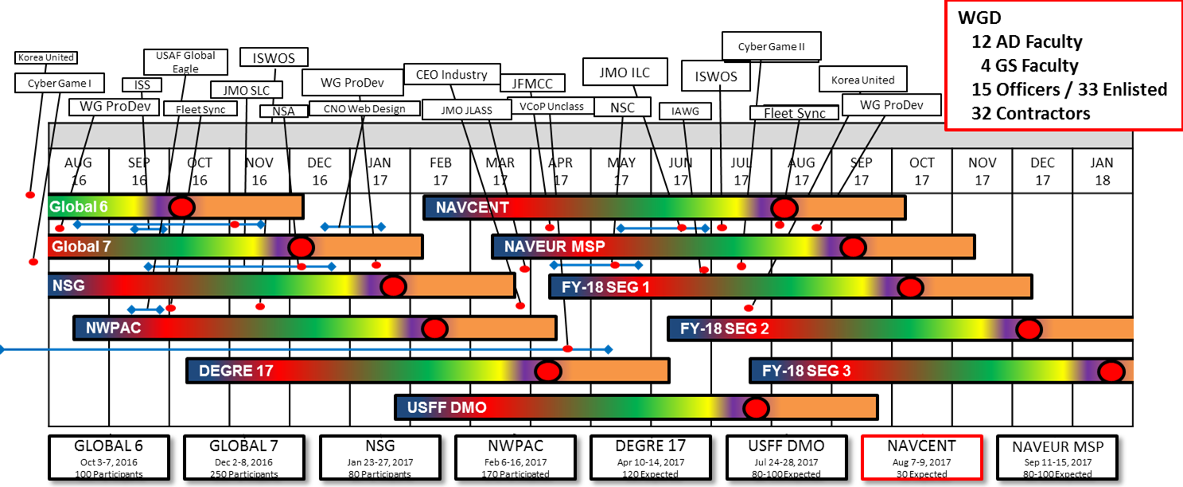
Wargaming @ Naval War College

Slide 27
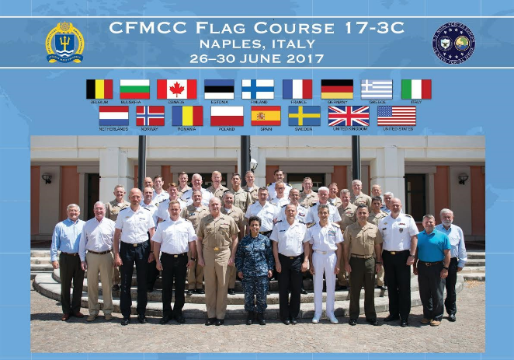
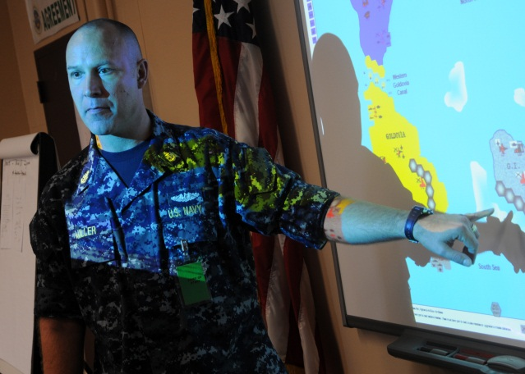
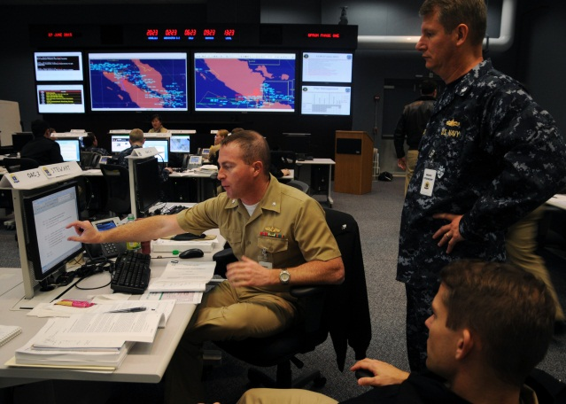
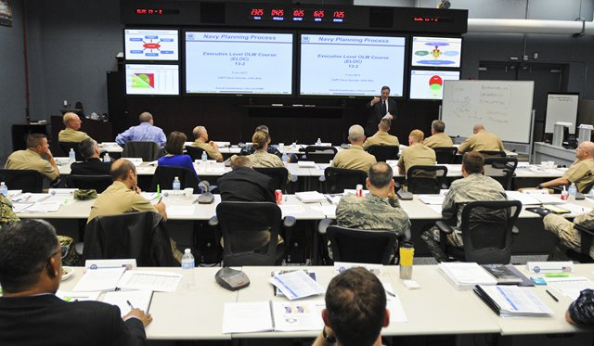
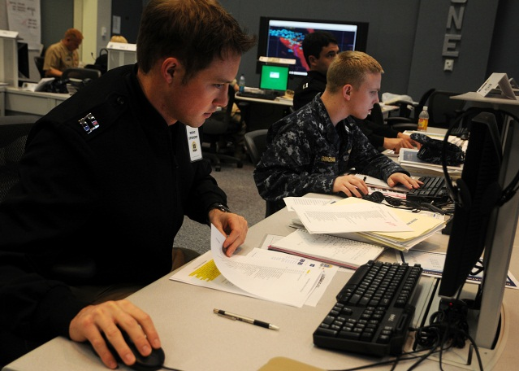
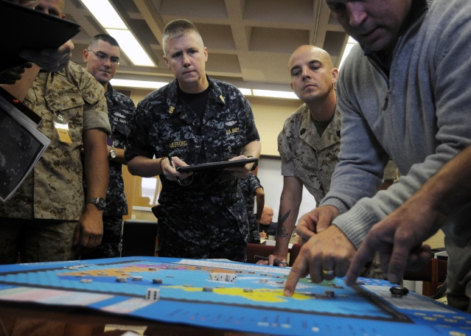
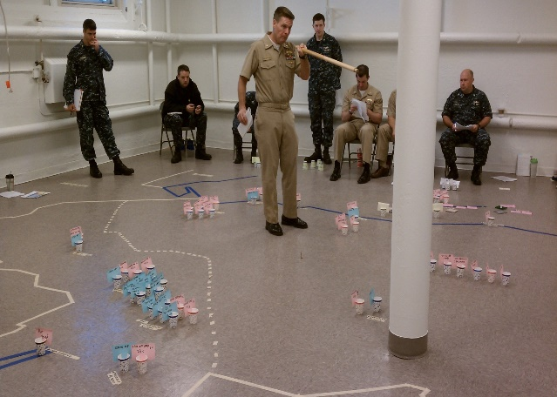
Mission Area Three
Support Combat Readiness
Notes:
The next major mission area involves efforts to support combat readiness. During the last decade, USNWC has reconnected directly with the fleet and the Navy’s operating forces. USNWC stood up the College of Operational and Strategic Leadership (COSL), now the College of Maritime Operational Warfare (CMOW), to provide the capacity to meet these additional OLW educational requirements in assisting the Navy to fully integrate into Joint Operations as a result of Goldwater-Nichols. Specifically, Goldwater-Nichols placed a heavy responsibility on our fleet headquarters under the Combatant Commands and we (the Navy) had not paid much attention to this critical area until back in 2005 under CNO ADM Mullen when he initiated the Maritime Operations Center (MOC) concept.
Additionally, COSL has lead for PNWC on leader development and military ethics in executing responsibilities in these areas across the U.S. Navy.

Slide 28
College of Maritime Operational Warfare
Courses:
Joint Forces Maritime Component Commander Course (JFMCC)
  ~24 FO/GO’s/Senior Civilians (once a year – one-week course)
Combined Forces Maritime Component Commander Cse (CFMCC)
  ~75 U.S. /Int’l FO/GO’s (2-3 times per year – one-week course)
Executive Level Operational Level of War Course (ELOC)
  75-100 O-6’s/Senior Civilians (3 times per year – one-week course)
Maritime Staff Operators Course (MSOC)
  400 U.S. Officers/Sr. Enlisted (16 times per year – 5 week course)
Maritime Operational Planner Course (MOPC)
  80 U.S. Officers (2 times per year – 11 week course)
Notes:
These are the courses we conduct. All are in Newport with exception of the CFMCC Flag Officer courses which we do in theater, focusing upon the region.

Slide 29
College of Maritime Operational Warfare
Courses:
International Maritime Staff Operators Course (I-MSOC)
  50 Int’l officers (2 times per year - 12 week course) [Support to IP]
Asia Pacific Navy Planning Process International Course (APNIC)
  35 Int’l officers (once per year - 2 week course) [w/JMSDF MCSC]
Future: Warfighting Course
  Throughput and periodicity TBD (3 week course)
More than 700 individuals per year!
Notes:
These are the courses we conduct. All are in Newport with exception of the CFMCC Flag Officer courses which we do in theater, focusing upon the region.

Slide 30
College of Maritime Operational Warfare
Outreach:
Assist & Assess Team (AAT) – works with Fleet Commanders and staffs at all the MOCs and CTFs. Includes Tailored Assist Visits (TAVS) for active duty, Reserves, and Int’l officers
  Ex: EUCOM maritime planning, Joint Cyber Task Force Certification, international engagement
Highly Qualified Expert (HQE) Program – retired Flag Officers (former Fleet Commanders) support courses and staffs
Humanitarian Response Program (HRP) – outreach with Academia, Non-Governmental/International Organizations, and Science & Tech; Research civ-mil interaction
Warfighting Development Centers (WDC) – working the seams
    Tactical to Op Level and between “Stovepipes of Excellence”
Notes:
These are the courses we conduct. All are in Newport with exception of the CFMCC Flag Officer courses which we do in theater, focusing upon the region.

Slide 31
College of Maritime Operational Warfare
Outreach:
  Theater Security Cooperation (TSC) – assist multiple Fleet staffs with TSC events; assist CPF with TSC for Maritime Security Initiative (MSI)
  Flag Officer “Development”– refreshes/updates U.S. Flag Officers on Operational Level of War concepts and regional challenges
  MOC Warfighter Journal – on-line forum to present and discuss maritime operational level of war issues
Notes:
These are the courses we conduct. All are in Newport with exception of the CFMCC Flag Officer courses which we do in theater, focusing upon the region.

Slide 32

Focus is Fleet Commanders
(Maritime Operations Centers)
10th FLEET
FLEET
FORCES
6th FLEET
7th FLEET
3RD FLEET
4th FLEET
PACIFIC FLEET
5th FLEET
Notes:
Where OLP is focused is our Fleet Headquarters around the globe: (8 MOCs, including 10th Fleet- our cyber force)

Slide 33

Mission Area Four
Strengthen Global Maritime Partnerships
Notes:
The fourth key mission area of the College is to "Strengthen Maritime Global Partnerships." This is a theme that permeates the revised Cooperative Strategy for the Twenty-first Century. As CNO, ADM Arleigh Burke, who introduced international officers to the College, said "Most important among people or among nations or among navies is friends." Building bonds of friendship and trust with our partner nations is the focus of International Programs. And, as you noted in your address to the Fleet, those bonds are the foundation of the naval profession – both at home and around the globe. The College's international alumni form a strong network of naval leaders who have confidence and trust in the NWC, the U.S. Navy and the American people that was formed by a solid understanding of our American values and way of life.

Slide 34


International Officer Enrollment
Naval Command College
  Started in 1956
  Senior Level Course
  50 Int’l Students / year
Naval Staff College
  Started 1972
  Intermediate Level Course
  60 Int’l Students / year
Both Fully Integrated with U.S. Students
Both Include a Robust Field Studies Program
Notes:
International Programs oversees two international colleges fully integrated into the US Nimitz and Spruance courses. The Naval Command College (NCC) provides senior-level JPME II strategic focus, while the Naval Staff College (NSC) provides a JPME I intermediate-level course focused more on an operational and theatre specific perspective. International students comprise 20% of the total number of students in their respective Nimitz and Spruance courses. Daily interaction is achieved by directly inputting international students into each seminar. Most often, two or three international students from different COCOM AORs will voice their opinions within seminar groups of 15. Coupled with the Naval War College (NWC) policy of non-attribution, seminar discussion is enriched with their presence.
Unlike their US counterparts in the Nimitz and Spruance courses, neither the NCC or NSC students are awarded a Master’s Degree. Newport’s Salve Regina University has a standing agreement to accept transfer credits for partial satisfaction of their Master’s degree program. Many international students concurrently attend both institutions, while others are able to extend their stay in the US and fulfill their requirements after the NWC June matriculation or via distance education upon return to their respective countries.
A main pillar of the two international programs is the Field Studies Program (FSP). This DoD-mandated program designed to provide our international students with an understanding of human rights, democratic values and the American way of life. Venues include federal, state and local government institutions, U.S. corporations, hospitals, prisons, universities and think tanks, as well as a broad swath of historical and cultural landmarks.

Slide 35

Global Impact
NCC NSC Total
Graduates 2,185 2,250 4,435
Flag Officers 1020 338 1,358
Chiefs of Service 314 141 455
Currently Serving Chiefs 21 26 38*
*8 graduates have attended both NSC & NCC
Notes:
As you can see from the chart above, International Programs here at the Naval War College has offered the US Navy an important tool for engaging with the leadership of the world’s navies and coast guards. Over 4,000 international officers have attended the War College since 1956. Over one-third have made flag rank. Most importantly, 37 heads of their respective services today are NWC graduates. Just as important, international students here develop close relationships with one another, as well as a broader and less biased perspective on regional and global politics. This was amply demonstrated several years ago after the terrorist attack on Mumbai. The tense situation between India and Pakistan may have escalated had the two CNO counterparts, former classmates at the US Naval War College, not maintained a close working relationship since departing Newport.
As one more example of the impact the Naval War College can have on its international alumni, the NCC Class of 1993, on their own initiative, returned in June 2013 for a "20th Reunion." Of the 36 officers who graduated from NCC in 1993, 8 went on to become head of their navy (1 of those became his nation's CJCS equivalent). Of the 36 officers, 12 chose to attend alumni week (with 3 US staff members from that time, for a total of 15 returning officers). Now 20 year reunions have become annual events for subsequent classes.

Slide 36
137 Countries Represented Since 1956
ALBANIA
ALGERIA
ANGOLA
ARGENTINA
AUSTRALIA
AZERBAIJAN
BAHAMAS
BAHRAIN
BANGLADESH
BARBADOS
BELGIUM
BELIZE
BENIN
BOLIVIA
BRAZIL
BRUNEI
BULGARIA
BURMA
CAMBODIA
CAMEROON
CANADA
CAPE VERDE
CHILE
COLOMBIA
CONGO
COTE D’IVOIRE
CROATIA
CUBA
DENMARK
DJIBOUTI
DOMINICAN REPUBLIC
ECUADOR
EGYPT
EL SALVADOR
ERITREA
ESTONIA
ETHIOPIA
FIJI
FINLAND
FRANCE
GABON
GAMBIA
GEORGIA
GERMANY
GHANA
GREECE
GRENADA
GUATEMALA
GUINEA
GUYANA
HAITI
HONDURAS
ICELAND
INDIA
INDONESIA
IRAN
IRAQ
IRELAND
ISRAEL
ITALY
JAMAICA
JAPAN
JORDAN
KAZAKHSTAN
KENYA
KHMER REPUBLIC
KOREA
KUWAIT
LATVIA
LEBANON
LIBERIA
LIBYA
LITHUANIA
MADAGASCAR
MALAYSIA
MALDIVES
MALTA
MAURITANIA
MAURITIUS
MEXICO
MONTENEGRO
MOROCCO
MOZAMBIQUE
NAMBIA
NETHERLANDS
NEW ZEALAND
NICARAGUA
NIGERIA
NORWAY
OMAN
PAKISTAN
PANAMA
PAPUA NEW GUINEA
PARAGUAY
PERU
PHILIPPINES
POLAND
PORTUGAL
QATAR
ROMANIA
RUSSIAN FEDERATION
SAINT KITTS & NEVIS
SAINT LUCIA
SAINT VINCENT & THE GRENADINES
SAMOA
SAO TOME & PRINCIPE
SAUDI ARABIA
SENEGAL
SEYCHELLES
SIERRA LEONE
SINGAPORE
SLOVENIA
SOMALIA
SOUTH AFRICA
SPAIN
SRI LANKA
SUDAN
SURINAME
SWEDEN
TAIWAN
TANZANIA
THAILAND
TOGO
TONGA
TRINIDAD AND TOBAGO
TUNISIA
TURKEY
UKRAINE
UNITED ARAB EMIRATES
UNITED KINGDOM
UNITED STATES
URUGUAY
VENEZUELA
VIETNAM
YEMEN
YUGOSLAVIA
ZAIRE
Notes:
International students have attended the Naval War College for almost sixty years. To date, over 137 countries have sent students, including some old enemies and new friends.
Inspiration for the initiative came from ADM Arleigh Burke, who felt strongly that international engagement during the tumultuous interwar years could have forestalled the Second World War, or at least made allied interoperability much easier.
The class of the Naval Command College is normally filled by officers from the world’s larger navies with close ties to the US. In contrast, the Naval Staff College tends to draw students from smaller, lesser-developed navies who do not have senior officers available for lengthy assignments overseas.
Of note, the People’s Liberation Army (Navy) has not been invited to send a student to the College, and it is unlikely they would accept an invitation so long as Taiwan sends students.
The college has initiated an exchange program with its Chinese counterpart, the PLA(N) Command College in Nanjing. A delegation of senior faculty, staff and students traveled to China this past summer and the college hopes to continue a two-way annual exchange.

Slide 37

International Fellows Program
CNO International Fellows:
  ADM (ret) Guillermo Barrera (Colombia)
  ADM (ret) Nirmal Verma (India)
  ADM (ret) Tomohisa Takei (Japan)
NCC/NSC Graduates Stay additional year:
(Co-moderate, Regional Expertise etc.)
  NCC: Chile – Agustin Pajaro
Personnel Exchange Program:
  JMSDF - CAPT Kats Yamamoto
  Germany - TBD
Administrative Personnel Exchange Program
  Germany - Mr. Christoph Swartz
Notes:
The International Fellows at NWC provide an international perspective at all levels into all we do here at the College. They are an organic resource that we can tap into directly for regional and in some cases global expertise. They contribute to our mission in a variety of ways, to include:
a. Conduct research on themes with relevance to a Fellow's country.
b. Assist in planning and execution of war games, subject to security considerations.
c. Assist faculty with the delivery of core curriculum or electives.
d. Provide regional expertise in support of Regional Study Groups.
The International Fellows Program functions at three levels:
1. CNO International Fellow Program: This was instituted in 2011 under ADM Roughead with the addition of ADM (ret) Guillermo Barrera (Colombia), former CNO Colombian Navy to the faculty. His contributions as an instructor, advisor to the NWC President, and mentor to current students have been invaluable.
The current CNO International Fellow is ADM (ret) Nirmal Verma (India), former Commander of the Indian Navy.
2. Naval Command College & Naval Staff College Fellows: These are graduates of the previous class who stay for an additional year and contribute in a variety of ways as described above.
3. Personnel Exchange Program (PEP) – JMSDF: This officer provides coordination for best practices exchange between USNWC and JMSDF Command and Staff College and acts as an augment to the NWC Faculty.

Slide 38

International Seapower Symposium
ISS XXII: 20-23 September 2016
475 Delegates; 94 Heads of Navy/Coast Guard
Professional Agenda
  Keynote speakers: DepSecDef; SECNAV; CNO; Commandant, USCG; Director, IMO; Former Indian CNO
  Regional Symposium Reports; Three HON Panels
  USN sets international agenda; promotes partnerships; drives interoperability
Ship Visit Program
ISS XXIII: 18-21 SEP 2018
Notes:
The International Seapower Symposium (ISS) is the largest conclave of naval leadership in the world.
The purpose of ISS is to create and solidify solutions within a global network of maritime nations to voluntarily harness the power of the international maritime community in order to effectively and efficiently confront common challenges and threats within the maritime domain.
Recent ISS's have seen a dramatic increase in participants since 1972, leading to increased bilateral CNO counterpart discussions, and regional breakout sessions. ISS XXI included 450 participants from 110 nations. Additionally, the Secretary of the Navy was able to capitalize upon the increases in African participation by convening a Gulf of Guinea forum prior to the commencement of events. ISS XXII seeks to build on these successes by requesting input from Numbered Fleets, Combatant Commands, and NWC Faculty for topic and keynote speaker recommendations and developing a professional program for CNO approval.
NWC and OPNAV N52 are working with FMB to procure funding to support ISS XXII as an unfunded requirement. Future ISS funding requirements may be best met through a programmatic approach.

Slide 39



Regional Alumni Symposia
Regionally focused professional symposia
  Coordinated through regional U.S. Fleet commanders
14 executed to date
  #11 SOUTHCOM, Rio, 12-14 May 2015
  #12 AFRICOM, Newport, RI, 25-28 August 2015
  #13 EUCOM, Garmisch, GE, 12-14 April 2016
  #14 SOUTHCOM, Lima, 21-23 March 2017
Linked to ISS
RAS SOUTHCOM
RAS
RAS
CENTCOM
RAS
AFRICOM
22nd International Seapower Symposium
RAS
SOUTHCOM
RAS
EUCOM
Notes:
U.S. Naval War College Regional Alumni Symposia are co-hosted by the President of the Naval War College and a partner war college or navy in the region. Participation is open to all graduates of the college, both international and U.S.
Symposia are academic conferences premised on the belief that military education is not solely the product of a schoolhouse, but rather a lifelong attempt to acquire knowledge about the profession of arms. Symposia include keynote speeches by prominent military leaders and faculty-led panels addressing strategic, operational, and technical issues of relevance to the region. All participants are invited to exchange insights and perspectives in a comfortable, not-for-attribution environment.
Symposia also foster professional interaction among up-and-coming military leaders in the region. Although most graduates remain in close contact with their classmates after graduation, and the College publishes regular alumni newsletters and professional journals like the Naval War College Review, symposia allow graduates to take advantage of the “Newport Connection” across many classes. This network promotes professional linkages among military officers at a crucial juncture in their careers when international contacts prove invaluable. World events continue to confirm the value of working with partners and friends. Trust can’t be surged.
Regional Alumni Symposiums (RAS) are aligned with ISS. Regional partners often develop solutions to their own challenges which have global applications. Good ideas culled from regional forums are presented at ISS so that they can be shared across the globe. For example, CUES were approved by the Western Pacific Naval Symposium in April 2014 and later highlighted at ISS XXI. Since then CUES has been discussed at three RAS’s. The ISS “Best Practices Exchange” was launched last year to spur more such exchanges.

Slide 40

New Initiative: International
Maritime Staff Officers’ Course
To improve Partner Capability & Capacity through Interoperability
12 week residential course that prepares international officers to serve on maritime operational level staffs.
Beta Course Spring 2017
  Notional goal - 25 students, 3 courses per year, commencing Spring 2018
Planning a Mobile Training Team and Exercise Support capability

Slide 41




Mission Area Five
Leadership and Ethics
Notes:
The fourth key mission area of the College is to "Strengthen Maritime Global Partnerships." This is a theme that permeates the revised Cooperative Strategy for the Twenty-first Century. As CNO, ADM Arleigh Burke, who introduced international officers to the College, said "Most important among people or among nations or among navies is friends." Building bonds of friendship and trust with our partner nations is the focus of International Programs. And, as you noted in your address to the Fleet, those bonds are the foundation of the naval profession – both at home and around the globe. The College's international alumni form a strong network of naval leaders who have confidence and trust in the NWC, the U.S. Navy and the American people that was formed by a solid understanding of our American values and way of life.

Slide 42
Leadership & Ethics
PNWC responsibility for Navy Leadership & Ethics:
  Leader Development Continuum Council (LDCC)
  Naval Leadership & Ethics Center (NLEC)
  Senior Enlisted Academy (SEA)
  Professional Military Ethics
  Flag Officer Development Continuum
Notes:
In 2008 the Senior Enlisted Academy was realigned under the USNWC as a first step in aligning Navy leadership and ethics education.
In 2011 USNWC was tasked by the Vice Chief of Naval Operations (VCNO) to develop and provide oversight for a leader development continuum for the Navy.
In January 2013 the Chief of Naval Operations (CNO) signed out the Navy Leader Development Strategy (NLDS) that explained how the Navy would develop leaders throughout a career.
In 2014 the CNO tasked PNWC with the primary responsibility for the education related aspects of the NLDS. This authority established USNWC as the lead institution and process owner for core values and ethical leadership development. Additionally, the CNO re-designated the Command Leadership School as a shore command under PNWC and established it as the Naval Leadership and Ethics Center. NLEC delivers courses for officers from Ensign to Captain and senior enlisted Sailors enroute to CMC/COB billets. They also have a spouses program for the Prospective Commanding Officer and CMC/COB courses. They have recently expanded their efforts to junior and mid-grade enlisted Sailors in order to provide them a continuum of development.
In the January 2017 Navy Leader Development Framework, the CNO tasked community leads to develop strategies for leader development up to the major command or equivalent level, and to brief their leader development program to the CNO/VCNO semi-annually. NWC was tasked to supplement and support each community, to maintain a strategy for leader development beyond major command, and brief the CNO/VCNO on this program semi-annually.

Slide 43
Major Lines of Effort
Naval War College
Leadership & Ethics Electives
Professional Military Ethics Symposia
Navy Senior Leader Development Concentration
Engaging students
Coaching & Assessment
NLEC/SEA Curriculum Support
Publications
Research
Navy
Leader Development Continuum Council (LDCC)
Navy Desired Leader Attributes (NDLAs)
Flag Officer Development Continuum
Leader Effectiveness Research
Community Leader Development Continuum Support
Notes:
The Dean of Leadership and Ethics has a small group of about a dozen academics and practionaires who are teaching faculty, support Navy leader development initiatives, and conduct research of leadership effectiveness to identify gaps in development; inform senior Navy leadership on leader development in the Navy; and inform various school houses to ensure leadership and ethics curricula remain relevant and leading edge.

Slide 44

Educating Leaders since 1884
www.usnwc.edu
http://www.twitter.com/NavalWarCollege
http://www.usnwc.edu/OnlineDiscussion
www.facebook.com/NavalWarCollege

