Slide 1
Ethical Leaders
Serve All & Eat Last
Colonel Chris Shaw, USMC
Staff Judge Advocate
III Marine Expeditionary Force
July 2017

Slide 2
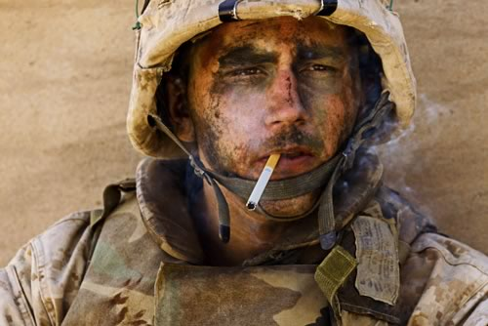
Ready to Lead in All Climes???

Slide 3
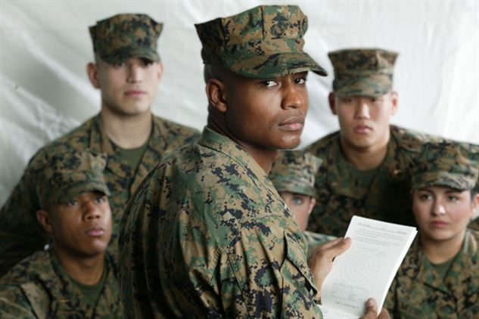
Your View When Leading???

Slide 4
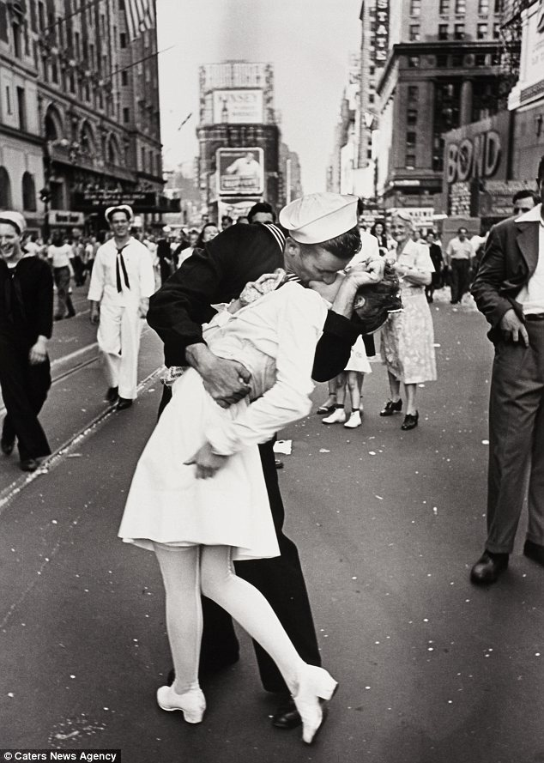
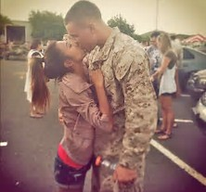
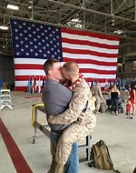
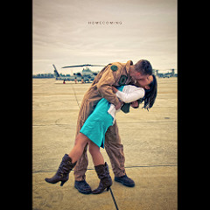
Is Your Leadership Consistent???

Slide 5
A War Fighting Imperative
‎“Leadership is the sum of those qualities of intellect, human under standing, and moral character that enables a person to inspire and control a group of people successfully.” Lieutenant General John A‎ Lejeune
Ethical Leadership is required to achieve the Marine Corps Manual Standard for relationship between officer enlisted (teacher and scholar, father and son).

Slide 6
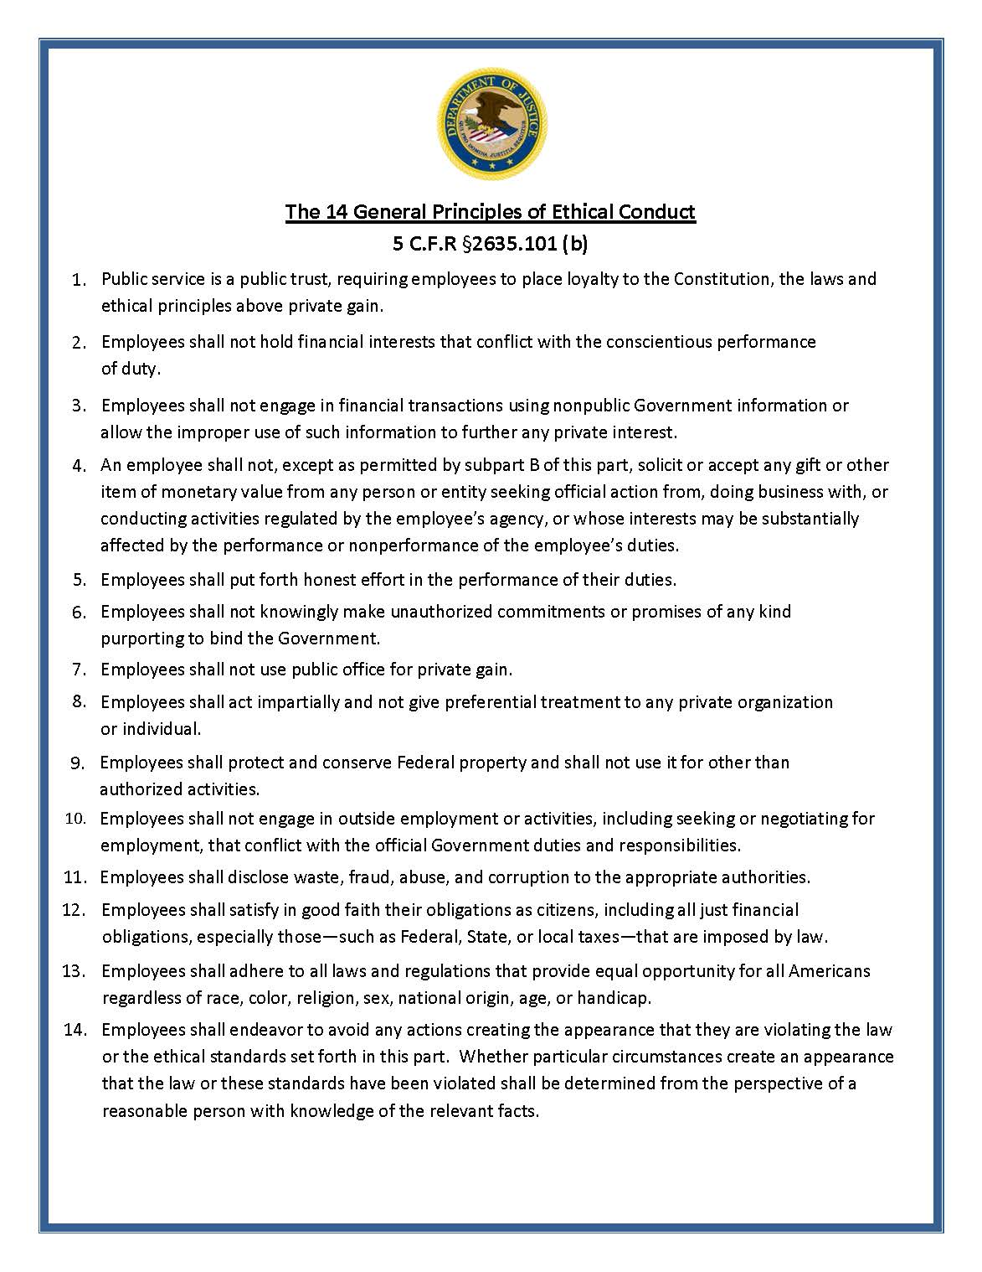
Ethics

Slide 7
Ethical “Do’s” and “Don’ts”
Do’s
#1 Place loyalty to the Constitution, the laws, and ethical principles above private gain.
#13 Comply with all laws providing equal opportunity to all persons, regardless of their race, color, religion, sex, national origin, age or handicap.
Don’ts
#7 Use public office for private gain to benefit yourself or anyone else.
#4 Solicit or accept gifts from persons or parties that do business with or seek official action from DOD (unless permitted by an exception).
#14 Take any actions that appear illegal or unethical.

Slide 8
Play in the Ethical Midfield
Personal Responsibility = Stay well inbounds.
If you play on the sidelines any misstep puts you out of bounds.
If you’re picking up chalk what are the LCpls doing?
YOU ARE the “Ethics Officer” for your unit.

Slide 9
Ethical IEDs
FY 12-15: 666 Substantiated IG allegations against FO’s/GOs/SESs and 89% in 4 categories:
Personal misconduct/ethical violations
Personnel matters
Travel violations
Misuse of government resources

Slide 10
GDMA (Fat Leonard) Case
Federal indictment against Marine O-6, numerous Navy Admirals, Captains and an NCIS Agent.
Accused of:
Providing classified info regarding ship movements to “Fat Leonard”, a Malaysian businessman who provided husbanding services to the Navy, and
Pushing Navy ships (including aircraft carriers) to “Fat Leonard” controlled ports where he charged the Navy millions of dollars for port services.
In exchange for: Prostitutes, Fine dining, Lavish hotel stays, and Cash.

Slide 11
Flag Using Racial Slurs
A rear admiral sent a racially offensive email to members of his command and HIS WIFE; and spoke in a manner diminishing confidence in or respect due to three superior admirals due to their race and gender.

Slide 12
Funded “Unofficial” Travel
A lieutenant general conducted official travel for predominantly personal reasons, which resulted in a waste of Government resources.

Slide 13
USMC Discrimination?
Racial Incident?
African American male LCpl was taking to another LCpl on the way to the smoke pit when a White male Cpl said “stop talking to my Marine before I hang your black ass.” The LCpl said “Racism must be real”, to which the Cpl replied “yes it is.”
Gender Incident?
During a counseling session on the CMC’s white letter on social media, a Sgt asked “what really happened?” A Cpl replied “a bunch of females took naked pictures of themselves and are now bitching for being exposed as the whores they really are.”

Slide 14
Social Media Conduct
Nonconsensual distribution or broadcasting of an image.
Facebook “Likes”, “friend”ing, broadcasting and other comments/actions.
Appropriate courtesies when texting or emailing seniors or juniors.

Slide 15
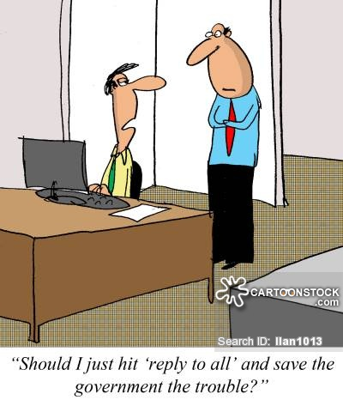
Professional Communication
Assume your e-mails will be read by the general public whether they are:
Released through a FOIA request;
Stolen by a hacker; or
Leaked by a disgruntled person.
Practical Considerations:
EAs have access to all principals’ e-mails.
assume that they will be read by others.
Atty-client privileged e-mails – disclaimer in e-mail does not provide absolute protection

Slide 16
Sexual Assault Release Card?

Slide 17
Not Reporting and Cover-ups

Slide 18
EP&A Association
The Ethical Protection & Accountability Association
Learn the rules
Seek assistance from peers, juniors, seniors, SJAs
Teach and discuss the rules
Serve as a role model
Redirect and counsel
Report when necessary
Don’t be an Ass (*NOT Defined in Black Law Dictionary)

Slide 19
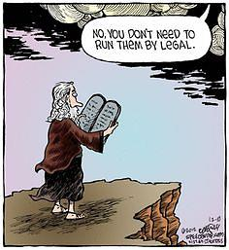
Questions?

