Slide 1
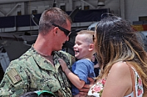
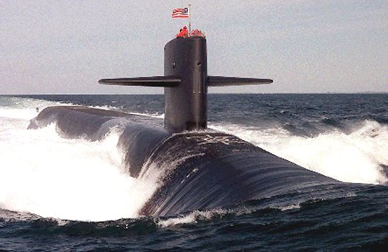
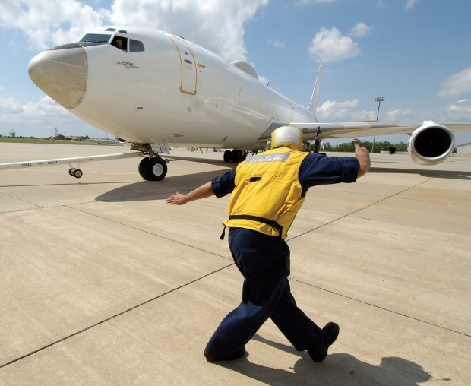
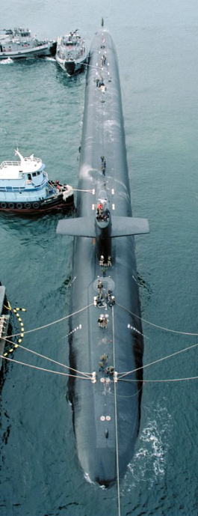
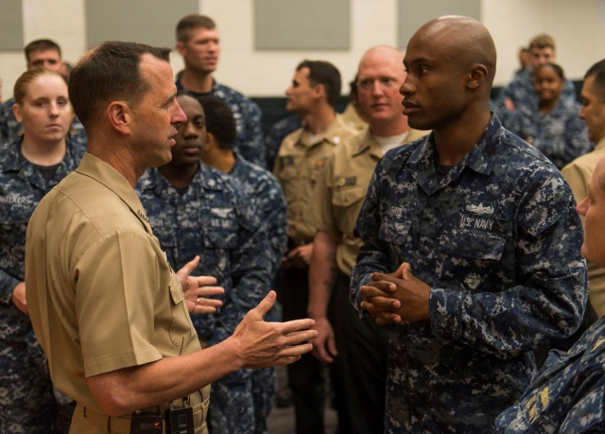
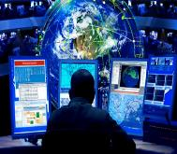
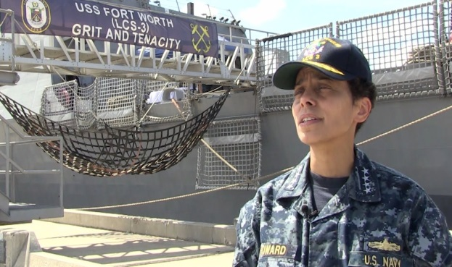
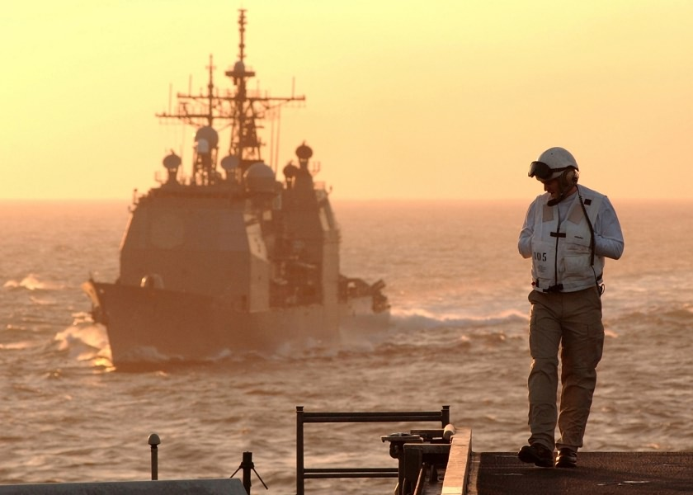
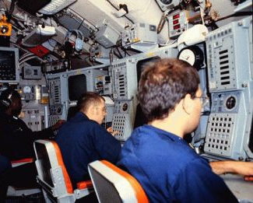
Developing Sea Service Leaders
Admiral Cecil D. Haney
USSTRATCOM

Slide 2
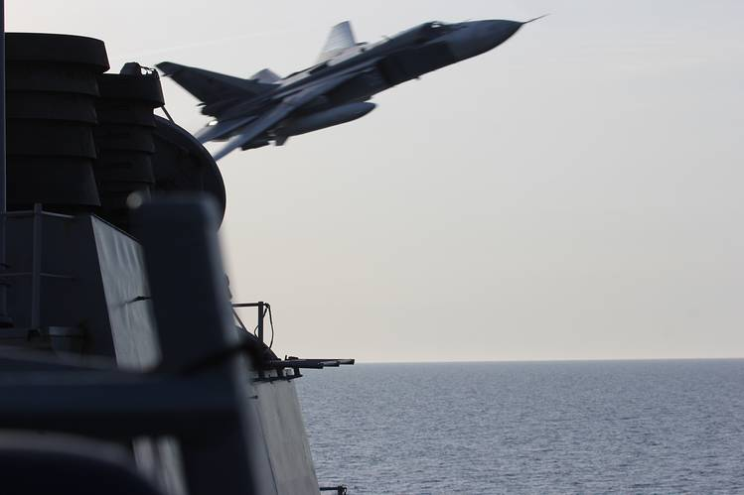
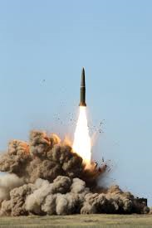
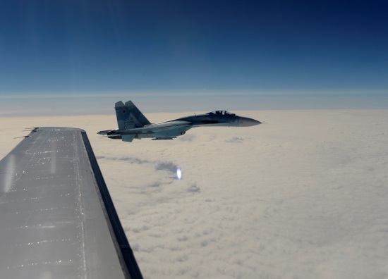
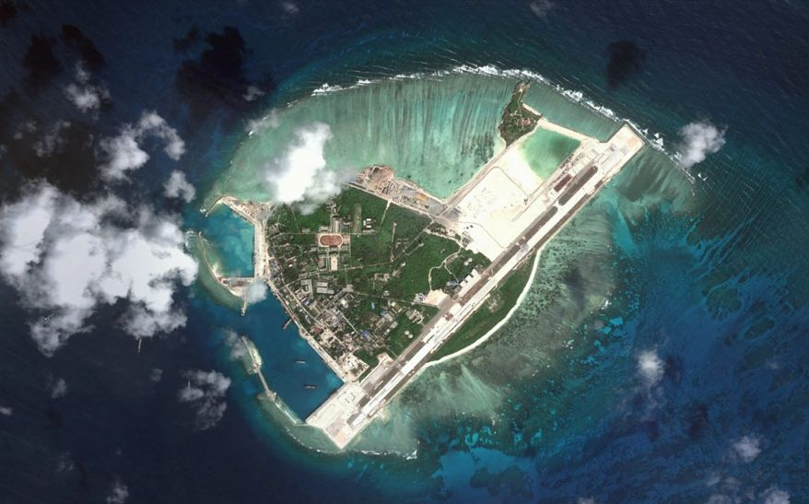
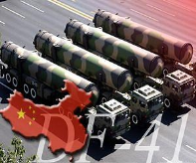
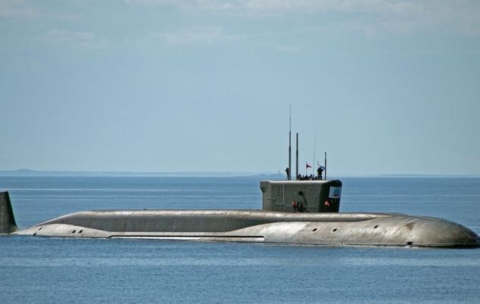
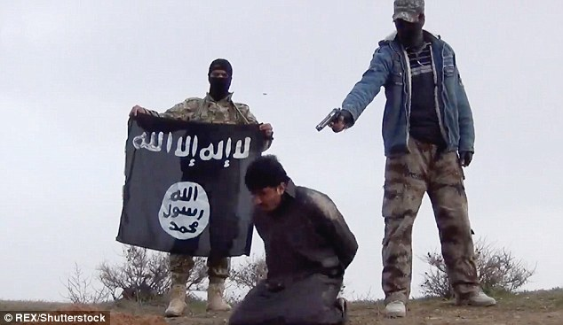
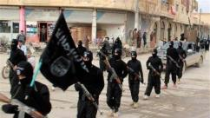
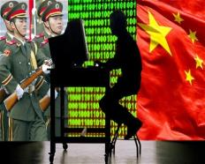
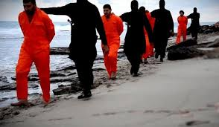
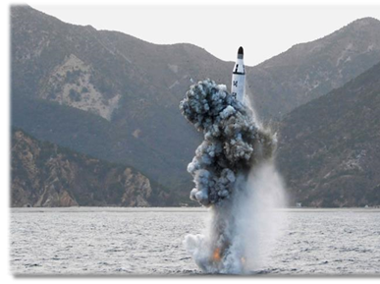
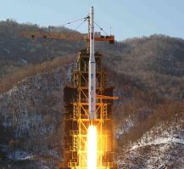
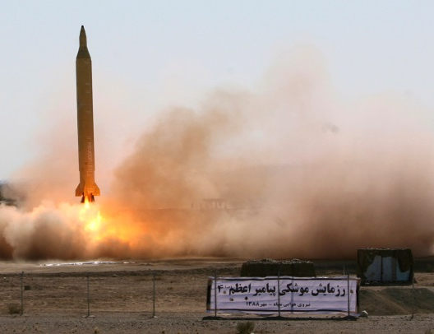
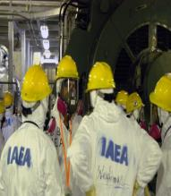
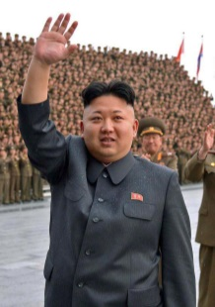
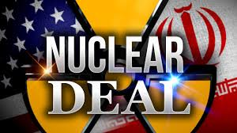
Strategic & Security Environment
Russia
China
ISIL
North Korea
Iran
“Existing world order is being redefined.” Henry Kissinger Jan 2015
2
2
Notes:
2

Slide 3
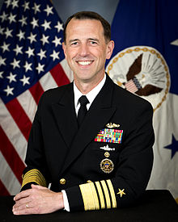
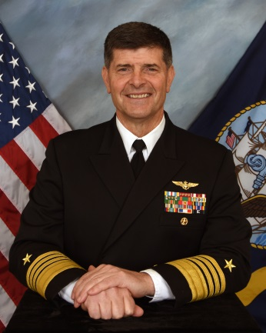
Shaping Future Leaders
Force of the Future requires a Culture of Learning
Stretch intellect beyond single domain problems
High-velocity learning / inquisitive minds
Purposeful discussions / complex scenarios
Are we fostering / encouraging diversity of thought?
ADM Richardson
ADM Moran
“…our force of the future has to be just as great, if not even better, than the outstanding force of today.” Sec Carter, 18 Nov 2015
3

Slide 4
Dealing With A Lot on Your Plate
Education
Family
JPME
Tactics
Meetings
E-mails
Teamwork
Safety & Security
Training / Qualifications
Subordinate Development
Training, Exercises, Inspections
Friends
Advancement
Warfighting & Deployments
Maintaining Tactical & Operational Proficiency
It Is All About Warfighting Readiness

Slide 5
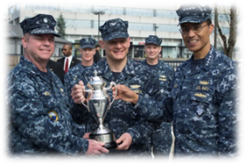
What Breeds Success?
Take a Long-Range View (where are the minefields?)
Creating a Thirst for Knowing “What is the Main Thing?”
Take Ownership
Develop a Questioning Attitude
Assess Your Progress & Make Timely Course Corrections
Over Communicate – Up, Down, Vertically, & Laterally
Mentor Struggling Individuals, Weak Teams
Mentor the Rest of Your Team
READ, READ, READ!

Slide 6
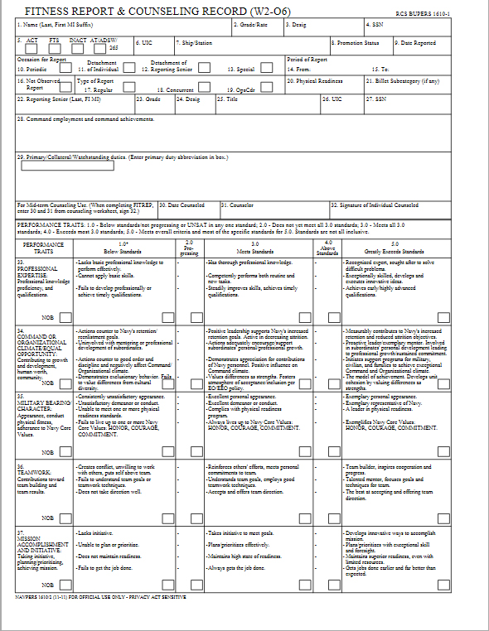
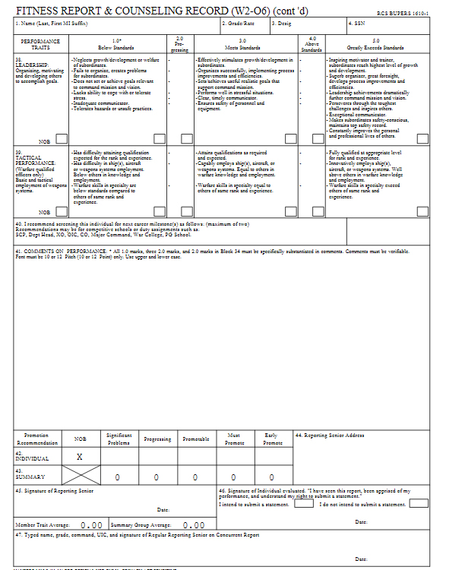
How Do You Know Where You Stand?

Slide 7
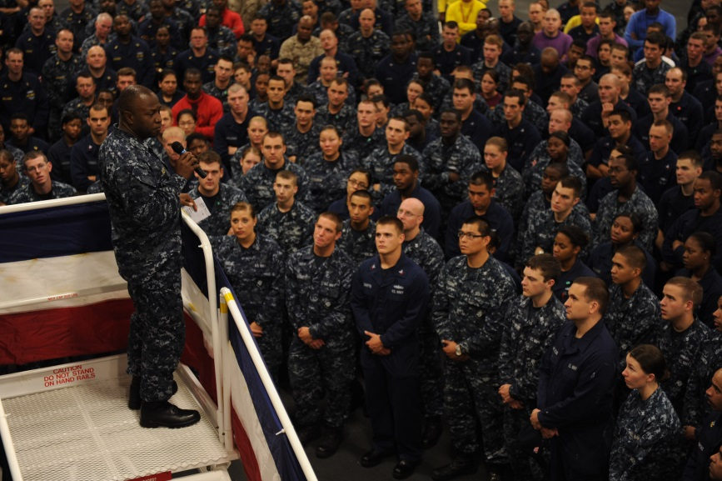
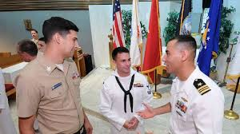
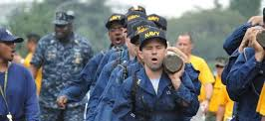
Your Leadership Matters!
How Will You Lead in the 21st Century Environment?

Slide 8
Backups

Slide 9
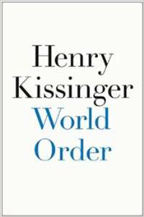
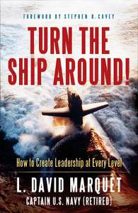
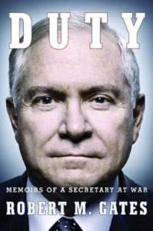
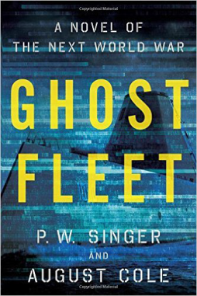
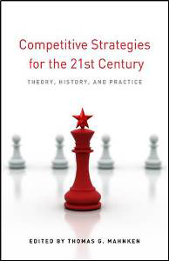
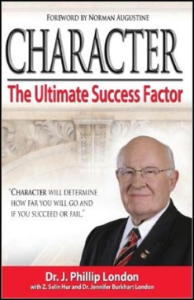
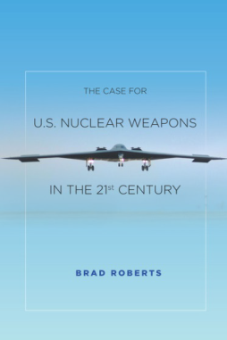
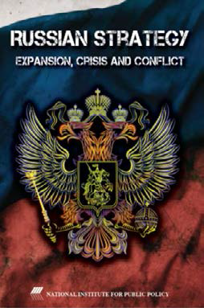
Recommended Reading
UNCLASSIFIED
World Order: Henry Kissinger (2014)
Duty! Memoirs of a Secretary at War: Bob Gates (2014)
Competitive Strategies for the 21st Century: Thomas Mahnken (2012)
Leaders Eat Last: Simon Sinek (2014)
Turn the Ship Around! L. David Marquet (2013)
Ghost Fleet – a Novel of the Next World War: P.W. Singer and August Cole (2015)
Character: The Ultimate Success Factor: Dr. J. Phillip London (2013)
The Case for U.S. Nuclear Weapons in the 21st Century: Dr. Brad Roberts (2016)
Russian Strategy: Expansion, Crisis and Conflict: Dr. Keith B. Payne (2016)

Slide 10
Spectrum of Conflict with Nuclear Adversary
UNCLASSIFIED
Integrated Tools
Diplomacy
Information
Military
Conventional
Cyber / Space
Nuclear
Economic
Decision Calculus
(specific to a decision)
Large Scale
Nuclear
Costs of Action
Benefits of Action
Benefits of Restraint
Costs of Restraint
Limited Nuclear
Off-ramp
Adversary action
US/Allied action
Decision/Escalation Control Point
Escalation Milestone
Nuclear
Capability Demo
Intensity
Conventional
Conflict
Off-ramp
Conventional Conflict Begins
Rhetoric, R&D, Misinformation
Other Dimensions of Crisis/Conflict
Hybrid Warfare
Off-ramp
Asymmetric Warfare
Off-ramp
Time Line
The “Art of Deterrence” Requires a Whole of Government Approach
10

