Slide 1
Aging and Wellness Throughout the lifespan

Slide 2
Why do some of us live longer than others?
Margaret Smith, 107 receives high school diploma 90 years after classmates. (June 2016)

Slide 3
What contributes to Longevity?

Slide 4
Genes (20%) vs Environment (80%)
Stanford University: Peter Pompei, MD

Slide 5
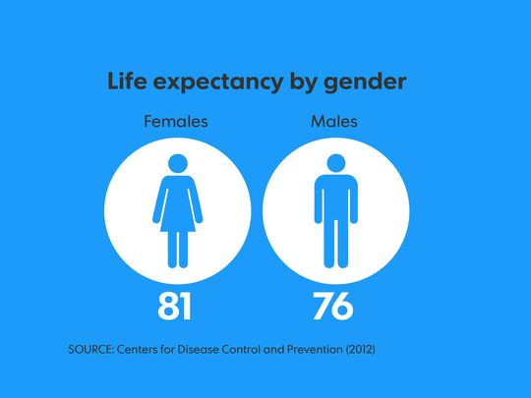
Current Life Expectancy in US
Most of us want to live to 87 years
Actuality 78.8
Center for Disease Control, 2012

Slide 6
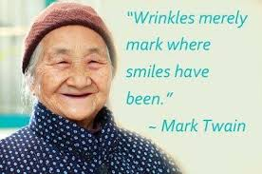
How Old is “Old”?
45 – 64: Middle Age
65 – 74: Young Old
75 – 84: Old
85 – 94: Old Old
95+: Oldest Old*
Fastest growing age demographic
American Society of Gerontologists

Slide 7
Leading Causes of Death in US
Center for Disease Control, 2014

Slide 8
World Health Organization Ranking; The World’s Health Systems (190 countries)
1 France
2 Italy
3 San Marino
4 Andorra
5 Malta
6 Singapore
7 Spain
8 Oman
9 Austria
10 Japan
11 Norway
12 Portugal
13 Monaco
14 Greece
15 Iceland
16 Luxembourg
17 Netherlands
18 United Kingdom
19 Ireland
20 Switzerland
30 Canada
37 USA
53 Jamaica
60 Philippines
61 Mexico
103 Iraq
112 India
125 Brazil
130 Russia
144 China
173 Afghanistan
190 Myanmar
World Health Organization 2014

Slide 9
US Aging Pyramid
Baby Boomers born (1946-1964)
PEW Research Center, 2015

Slide 10
76 Million Baby Boomers
Born between 1946 – 1964, Boomers are from 51 – 71 years old now.
For the next 15 years, 10,000 people per day will turn 65.
The lifestyle and exercise decisions they make now will define the rest of their lives.

Slide 11
Aging to 90+
90+ fasts growing segment of population
Case study started in 1981 – present
Leisure World in CA
Laguna Woods
14,000 people surveyed
Diet, exercise, vitamins, food, activities, etc.
1,600 found and tested (2003 -present)
Claudia Kawas MD 2012

Slide 12
Findings?
Smokers died sooner
Don’t over worry about health/food/etc.
Low stress
Exercise 45min average per day
Could be broken up
Vitamin supplements made NO difference
Vit. A,E,C and calcium
Alcohol in moderation (2 drinks a day)
Did not matter what type
Caffeine 1-3 cups of coffee average (200-300mg)
Leisure activities (up to 8 hours daily)
Use of soft drinks and teas made NO difference
Body Weight slightly overweight lived longer
vs. those underweight or obese
Dementia starts at age 65 and doubles every 5 years
Donating brain after death
Claudia Kawas MD 2012

Slide 13
Dementia
Dementia is a general term for a decline in mental ability severe enough to interfere with daily life.
Unfortunately no blood test or exam
Totally silent
Low BP = key predictor
High BP = low chance of dementia
People with no signs of dementia still had plaques and tangles
So far results show no matter what you do nothing prevents some type of dementia
University of CA at Irvine

Slide 14
What does it look like

Slide 15
Alzheimer’s Disease
A general term for memory loss and other intellectual abilities serious enough to interfere with daily life.
Alzheimer's is the most common form of dementia and accounts for 60 to 80 percent of dementia cases.
Alzheimer’s caused by micro-strokes
holes in the brain not the tangles or plaques

Slide 16
Alzheimer's

Slide 17
National Geographic study
Plant based diets, meat sparingly
Daily lower intense exercise
Less than 2% smoked
Moderate alcohol use
Whole grains, Omg 3
Not less stress, but how they dealt with it
Faith, no matter what religion
Sense of community, network
National Geographic study 2005

Slide 18
Nutrition Connection to Longevity
1600-1800kcal diet
Weight bearing exercise more important
Avoid high fructose corn syrup
5-9 fruits and veggies a day
25-35gm of fiber a day
Increase intake of Omega3 (anti-inflammatory)
Avoid excess caffeine, sodium, cigarettes, antacids, thinness (osteoporosis)
Eat food not “edible food-like substances”
Vicki Newman MD

Slide 19
Height Connection to Longevity
Good news for us short guys!
Genotype – FOXO3
Shorter men were also more likely to have lower blood insulin levels, and were less likely to have cancer in their lifetime. (8,000 men)
Bradley Willcox, University of Hawaii 2014

Slide 20
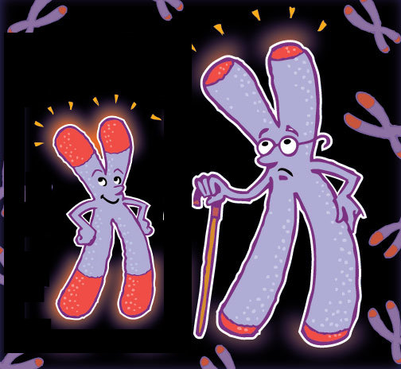
Can we really control aging?
Telomeres shorten as we get older causing aging in our cells.

Slide 21
Telomeres and cell aging
We inherit telomeres from our parents, but no matter the length of our telomeres at birth, everyone’s get shorter as they age.
Shorter telomeres have a negative effect on our health.
Telomere shortening is the main cause of age-related break down of our cells. (Birth 15,000 bases - 5,000 at death) When telomeres get too short, our cells can no longer reproduce, which causes our tissues to degenerate.
Some cells, like those found in the skin, hair and immune system, are most affected by telomere shortening because they reproduce more often.
Bill Andrews, PhD Sierra Sciences 2013

Slide 22
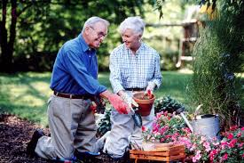
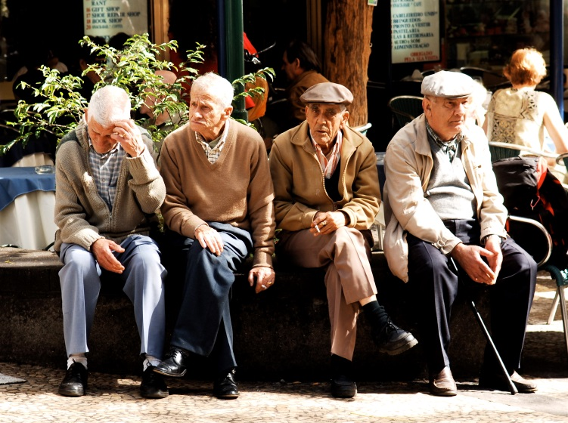
So what can we do?

Slide 23
Tips for healthy aging
Detoxify our diet
Medical screening and early diagnosis
Change bad behaviors (smoking)
Avoid poisonous foods
Hormone balance
Exercise
Proper nutrition (water, fiber, fish, etc.)
Manage stress
Sense of purpose (give back)
Care for others (family, friends)
DaSilvia Institute, 2016

Slide 24
Additional things to consider
Healthy parents produce healthy children – “we are what we eat” or imitate
Be hardworking – prudent humans live the longest
Avoid Bachelorhood – Married men live 10 years longer than single or divorced
Longevity Project, 2011

Slide 25
Your Homework
How long will YOU live?
Lifespan calculator
http://media.nmfn.com/tnetwork/lifespan/#0 How long will I live?
https://www.myabaris.com/tools/life-expectancy-calculator-how-long-will-i-live/ Living to 100
https://www.livingto100.com/

Slide 26
“My job is to help you DIE, healthier!”
Paul Knapp BS,MA,CPT
Boone Medical Clinic
Health Promotion Department
757-462-1734

