Slide 1

Promotion Boards Brief
CAPT Terry Morris

Slide 2
COMMUNICATION
12 - 15 months from PRD
  Start thinking about your preferences
  Seek out opinions and guidance
9 - 12 months from PRD
  Communicate preferences to Detailer
  Ask questions
6 - 9 months from PRD
  Commit to orders
  Work out timing
3 - 6 months from PRD
  Orders
Lack of communication ≠ recipe for success

Slide 3
CARRER MILESTONES
WHEN DO I MAKE O - 4?
  Rough timing: YG + 9
Example: YG 2006
2006 + 9 = ~ 2015 In - zone
WHEN SCREEN FOR DH?
  Rough timing: YG + 10
  ADHSB occurs 1 year after your O - 4 screen board (First Look)
DH timing based on CDR promotion zone
For exact timing: Reference the Bubba List
  Request Bubba List from your Front Office

Slide 4
RECORD REVIEW
You are responsible for your record
A complete and accurate record = your resume
Check your record at: www.bol.navy.mil
  Officer Military Personnel File (OMPF)
    All documents
  Officer Summary Record (OSR)
    Education
    Personal Decorations - “Awards”
    Special Qualifications
      Additional Qualification Designators (AQDs)
      Navy Officer Manpower and Personnel Classifications (NAVPERS 15839I)
  Performance Summary Record (PSR)
    Check against FITREPs
    Check for continuity (gaps < 90 days), legibility

Slide 5
RECORD REVIEW
NPC is always behind in processing Awards and in some cases FITREPS.
IF YOU REMOTELY SUSPECT THE BOARD DOES NOT HAVE YOUR COMPLETE RECORD (MISSING AWARDS, FITREPS, AQD’S) SUBMIT THAT MISSING ITEM DIRECTLY TO THE BOARD AS CORRESPONDENCE.
We can assist you with record management, please ask us if you have questions.

Slide 6
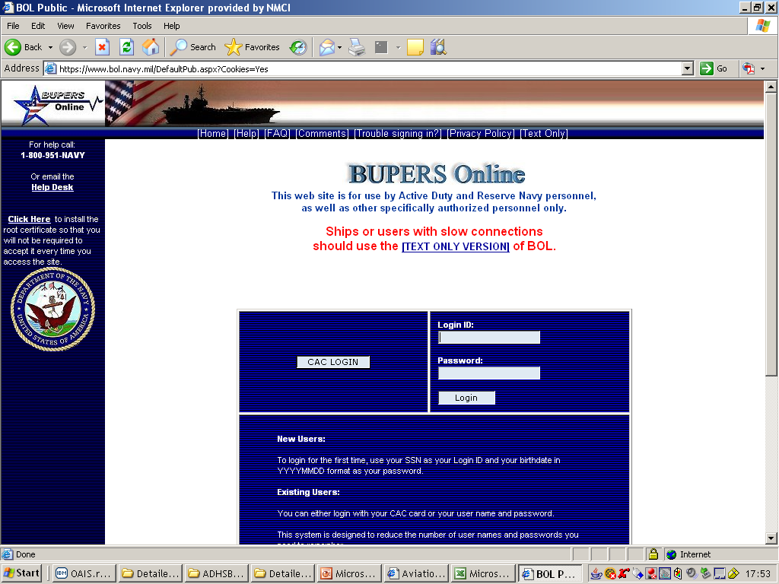

Slide 7
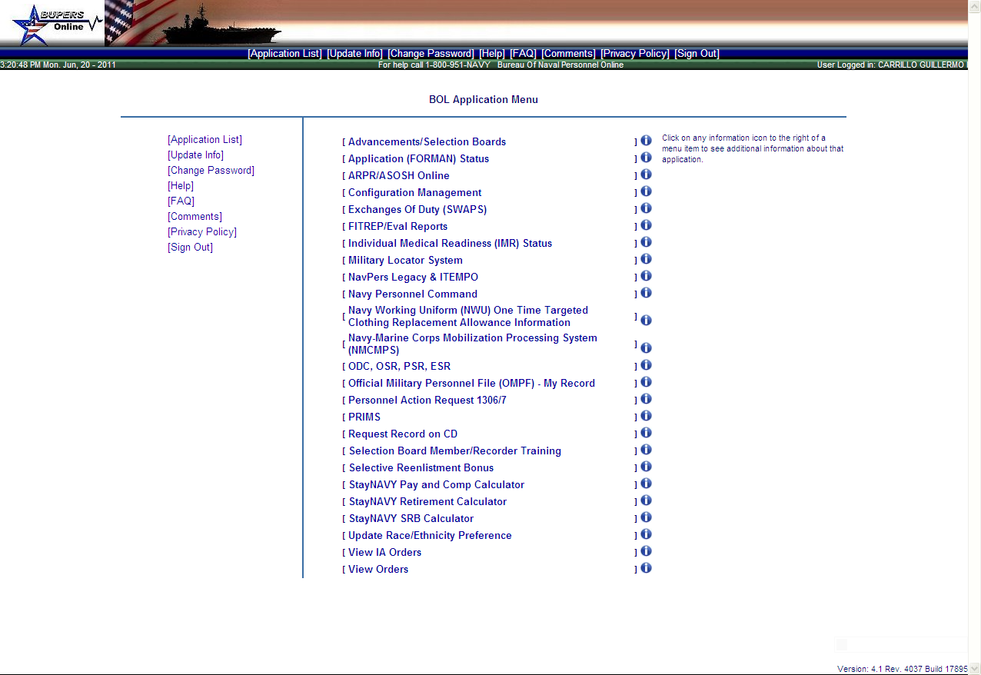

Slide 9
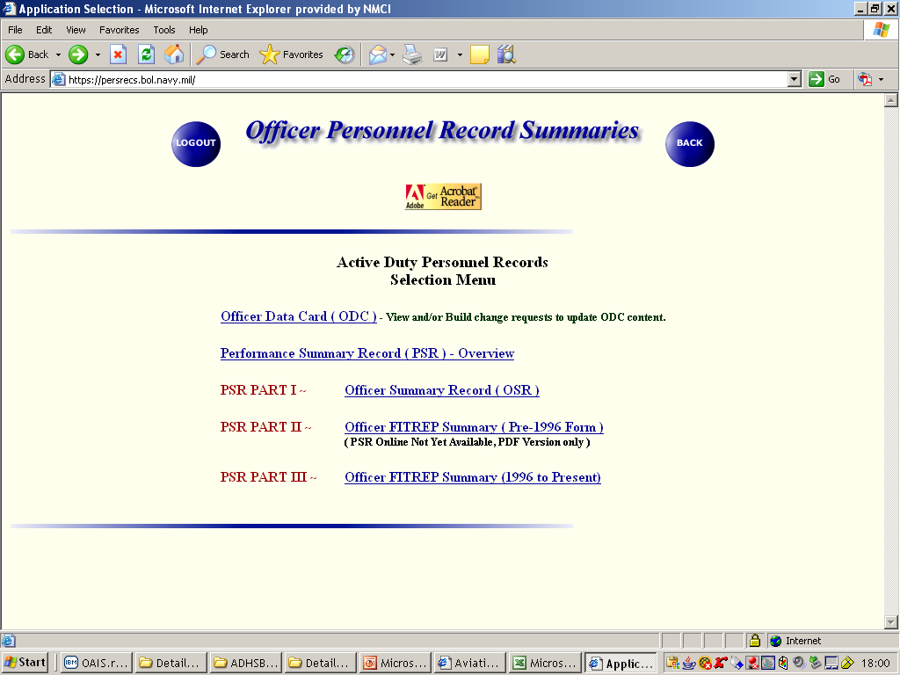

Slide 10
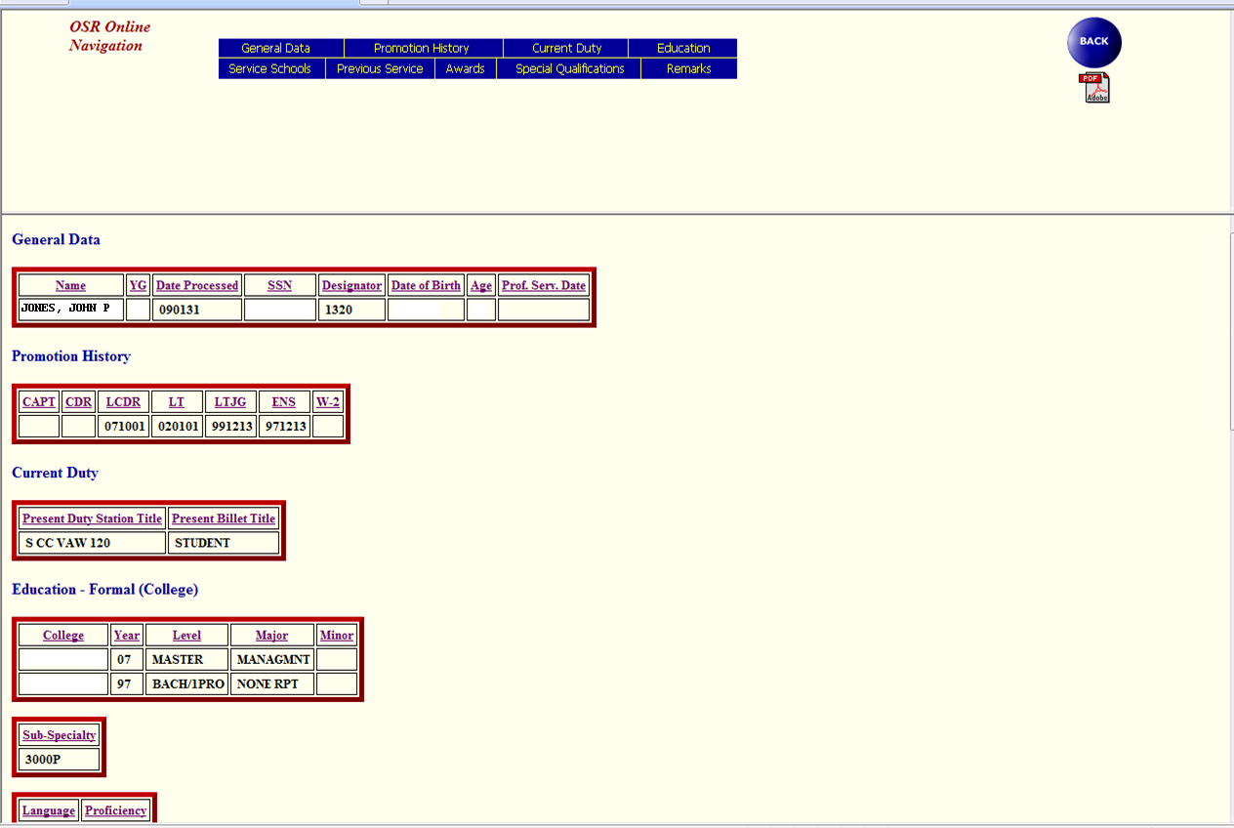

Slide 11
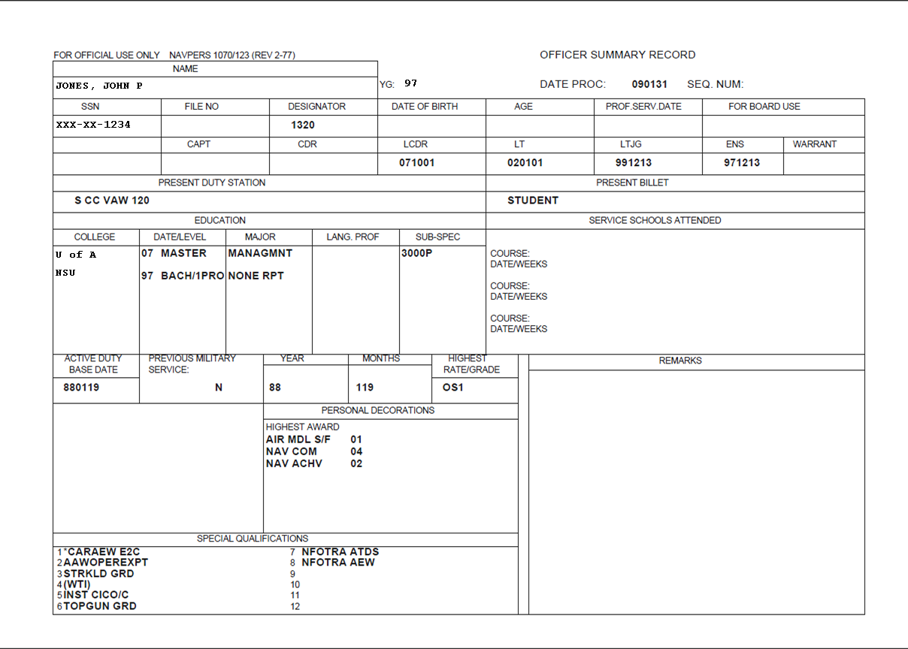
OSR

Slide 12
Education

Slide 13
Previous
Service

Slide 14
Awards

Slide 15
AQDs

Slide 16
Limit the amount of
blank fields

Slide 18
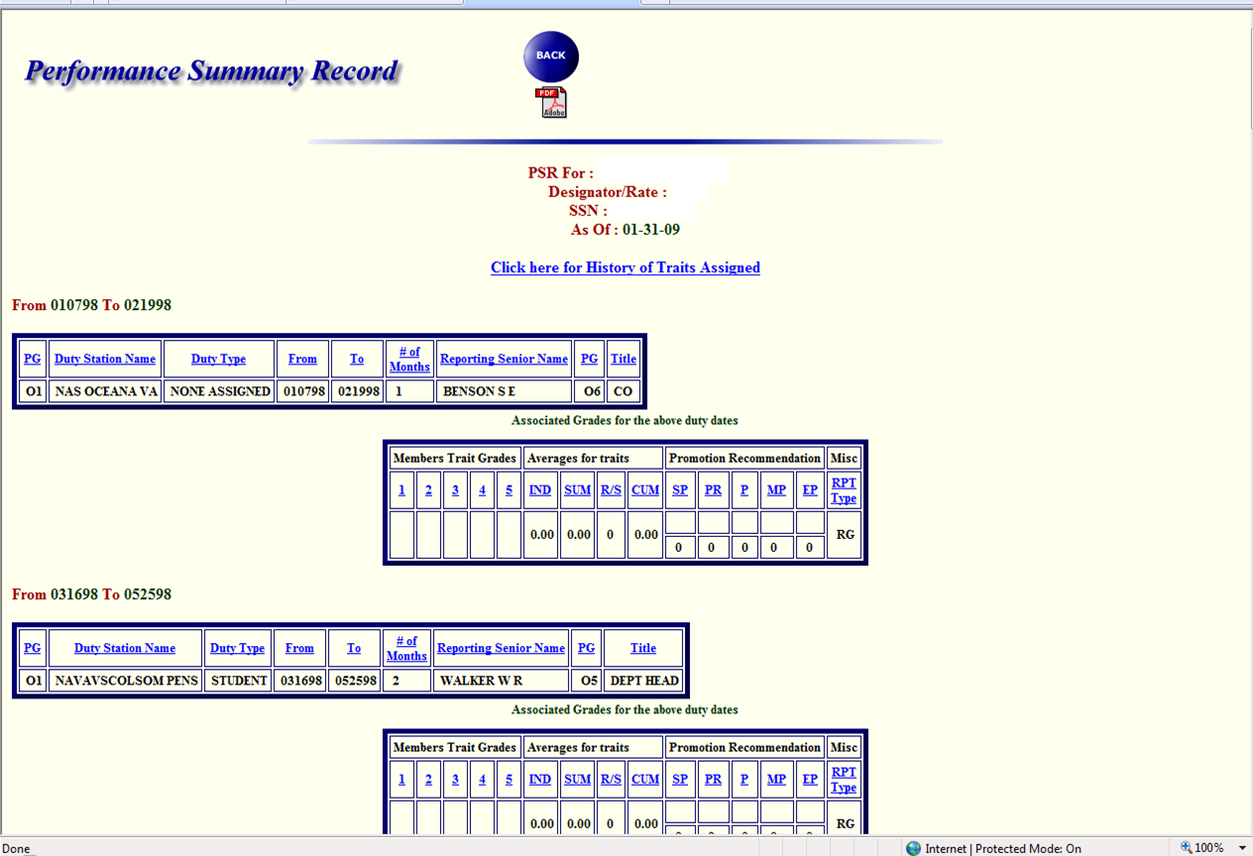

Slide 20
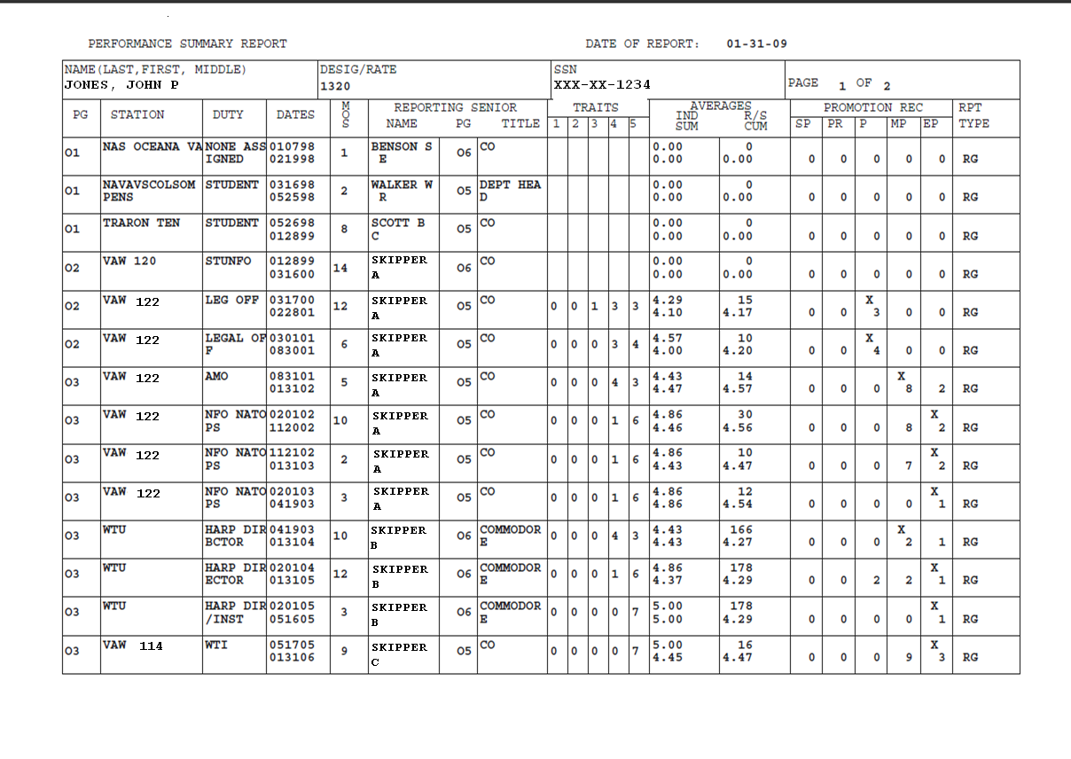
PSR

Slide 21
Are You Missing Any FITREPs?

Slide 23
NUMBER OF REPORTS
TO BUILD AVERAGE
INDIVIDUAL TRAIT
AVERAGE
SUMMARY GROUP
TRAIT AVERAGE
REPORTING SENIOR
CUMULATIVE AVERAGE

Slide 24
OVERVIEW
PART I
  Detailer vs. Placement
  Career Progression
  Saved Rounds
PART II
  Record Review
  Selection Boards 101

Slide 25
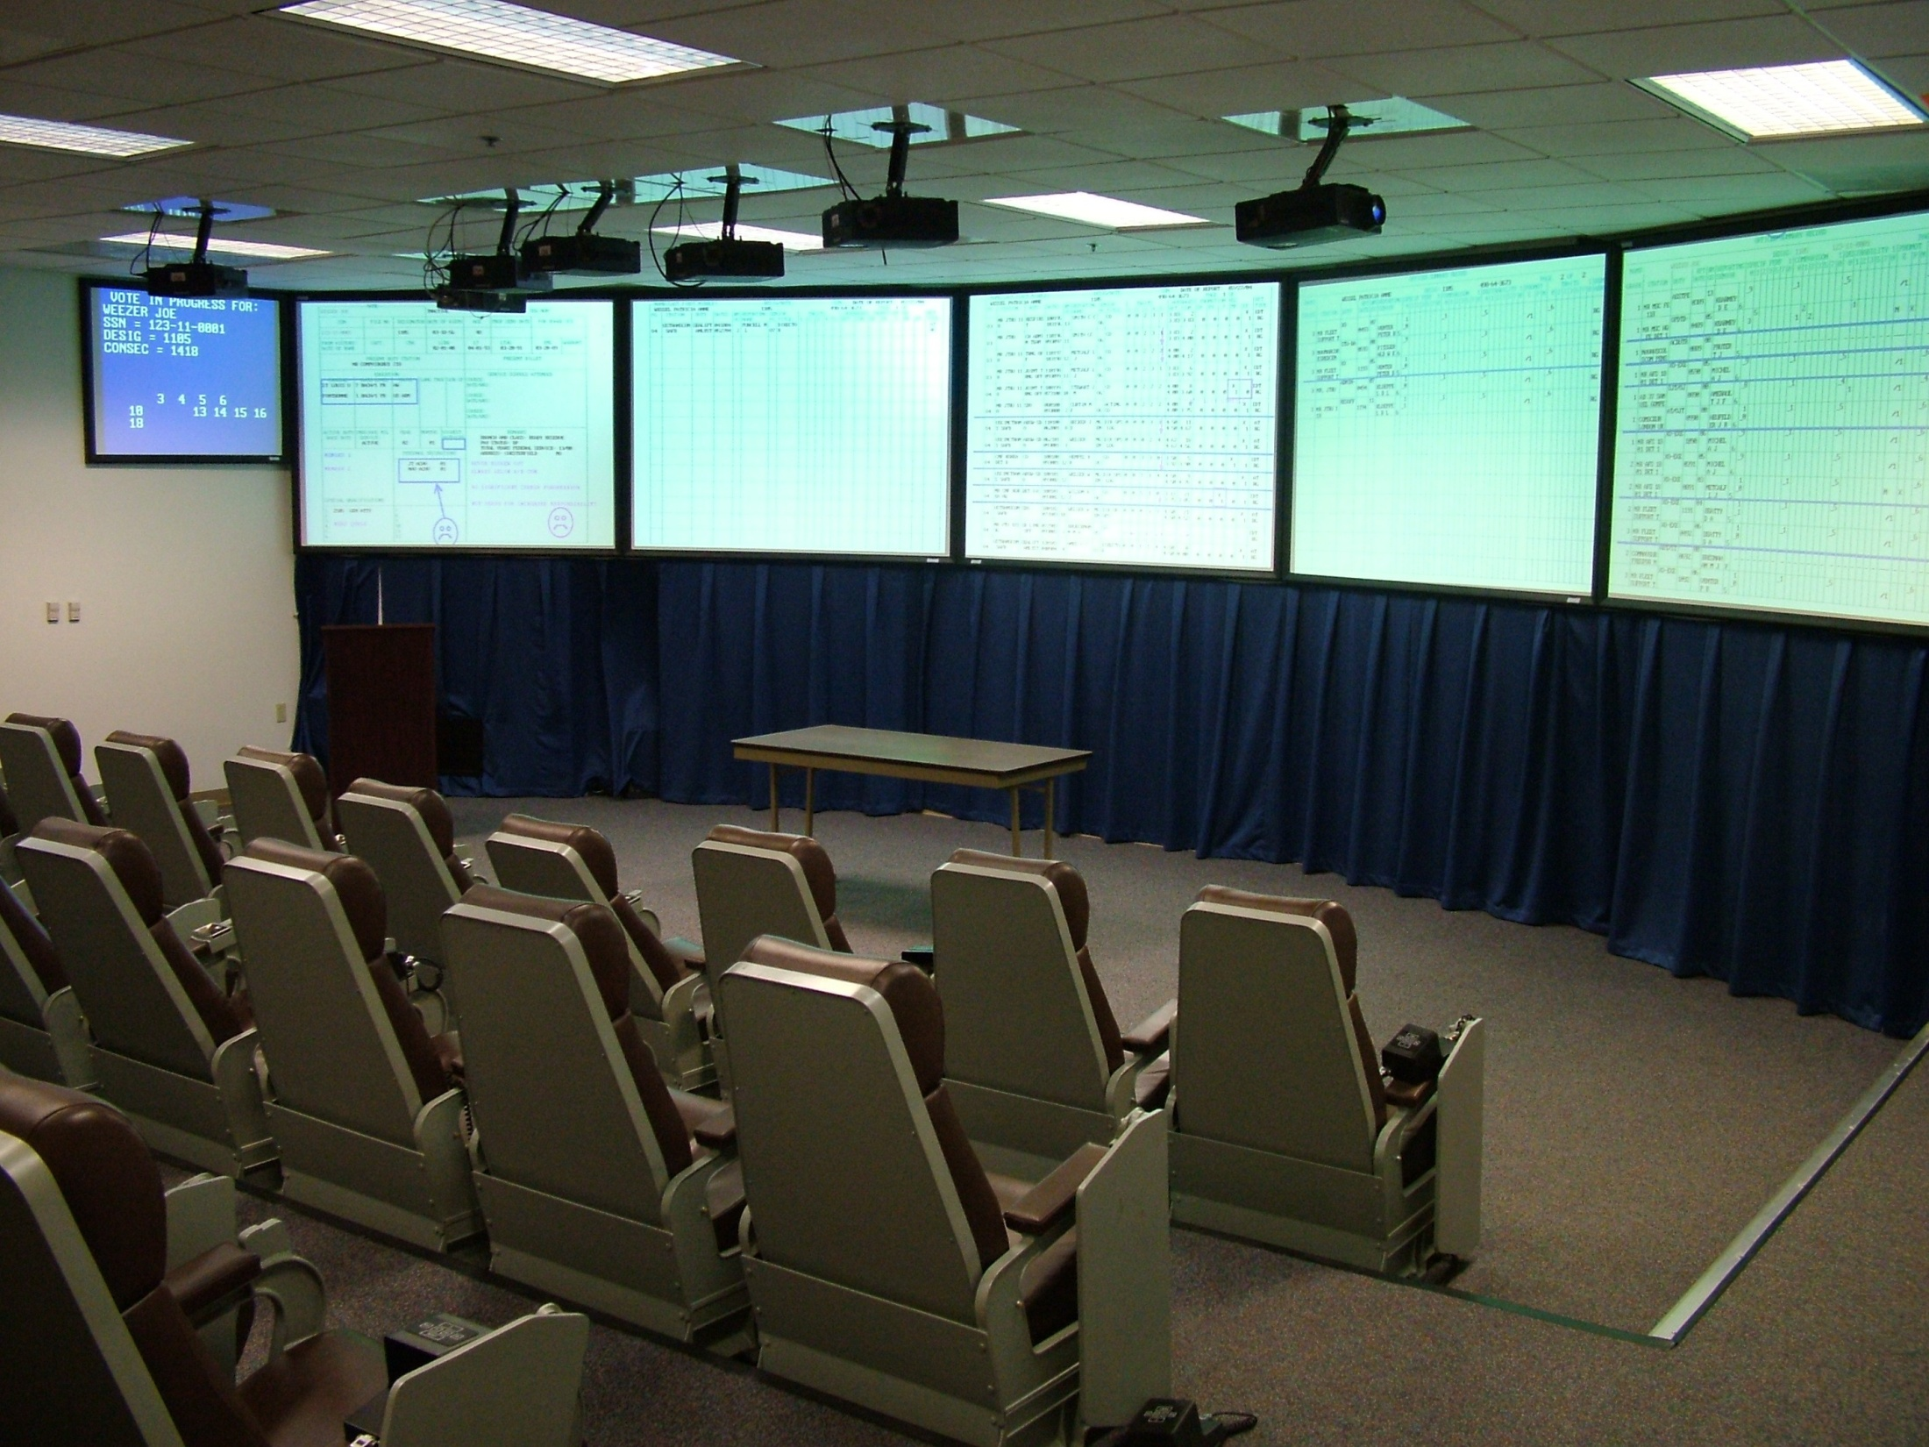

Slide 26
JPME
CDO(U)
GSA/IA
OVERSEAS
MAJOR STAFF
JOINT
Briefer highlight section

Slide 27
2/23 HBO
1/6 HBO
1/27 SBO
NBO
DT #1! 2x COs
UNCLASSIFIED

Slide 28
SCATTERGRAM
# PCT / # CUM
100
97
94
93
91
87
83
80
77
74
71
3
3
2
3
2
3
5
6
3
6
8
11
13
16
21
27
100
97
94
93
91
87
83
80
77
74
71
Tentatively Select
“Crunch” 8 records
to select 4
Remove From
Consideration
PCT (Confidence Score)
UNCLASSIFIED

Slide 29
Selection Boards 101
Statutory Boards
  Promotion Boards
Administrative Boards
  Screen Boards

Slide 30
PROMOTION BOARDS
Direct competition with your screen group
  Screen group is a grouping by lineal number
  Across all URL communities
  Adjusted annually by the mid-December “zone projection message”
  *If you look at the bubba list one time during the year, look after the zone projection message is published.
Number selected:
  Based on mandated end strength requirements

Slide 31
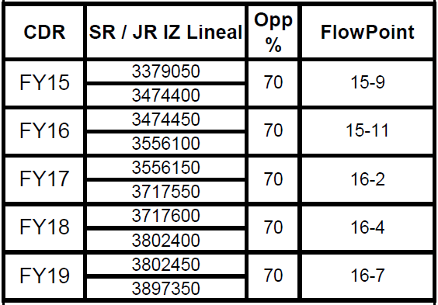
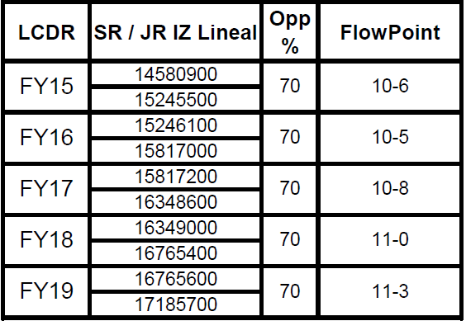
PROMOTION ZONE FORCAST

Slide 32
PROMOTION BOARDS
Overall NAE FY16 (2015) O - 4 Selection Rate 72%
  Largest community of officers in USN
  Historical selection rate of 80% decrease to 70% in 2012
  Returned to 80% rate in 2015
  Increased to 85% for 2016
O - 4 currently biggest hurdle in Naval Aviation
  Minimum Service Requirement (MSR)

Slide 33
FY16 ADHSB Takeaways
Best and Fully Qualified Standard
  Record of sustained superior performance in operational environments and ashore
  Warfighting ability and tactical excellence
First sea tour (DH screen rates)
  82% - #1 EP
  67% - #2 EP
  66% - #3 EP
  60% - #4 EP
  50% - #5 EP or lower

Slide 34
NAE TAKEAWAYS
All officers must be proactive in keeping their records up-to-date
  OSR / PSR / OMPF
    Ensure there are no FITREP gaps, missing qualifications and missing awards
Sustained superior performance continues to be the key to achieve career milestones
In order to pick the best and most fully qualified officers to fill aviation DH billets, the ADHSB will continue to be required.

Slide 35
COnclusion
Talk with your mentors, chain of command and community leadership and make an informed decision
Work with Detailer each step of the way

Slide 36
Questions?
Notes:
References
Task Force IA NAVADMINs
OPNAVINST 1001.24
Future MILPERSMAN article
GSA
PCS orders to one of two Expeditionary Combat Readiness Center Detachments (ECRC Det Norfolk or Det San Diego)
En Route intermediate temporary duty stop at one of four Navy Mobilization and Processing Sites (NMPS San Diego, NMPS Norfolk, NMPS Gulfport or NMPS Port Hueneme. Approximately 5 days.
Upon reaching ECRC, will await onward transportation to report to a Stateside training site for follow-on training in a temporary duty status. Upon completion of pre-deployment training, will deploy in support of a GWOT mission requirement.
ITDY orders allow funded moves for a member’s dependents to a designated place of residence while member deployed. Family also entitled to PDS move.

Slide 37
Aviation Career Path
Critical Decision Point
1st contact w/ detailer
DUE COURSE
FRS
DH
2nd
SHORE
FRS
XO/
CO
MAJOR
FLT
TRNG
FRS
1st SEA
1st SHORE
2nd SEA
SHORE/
SEA
SHORE/ SEA
SHORE
SEA/
OVER-SEAS
SHORE/ SEA
SHORE/SEA
Acft/Tactical
Quals
Production
Masters
USNA
ROTC
PEP
Staff
Ship
Afloat
Staff
Squadron
NON DUE COURSE
DC
JOINT
Staff
Navigator
Amphib
Air Boss
Staff
Educ/JPME
Afloat Staff
Ship
DC
Staff
CVN Sfty
CVN Wep
DC
JOINT
Staff
JPME
MSR: Time After “Wings”
0 2 4 6 8 10 12 14 16 18 20 22 24 26 28
O-4 BRD
ADHSB
O5 BRD
ACSB
O6 BRD
AMCSB
STATUTORY BOARDS:
LCDR – 80%
CDR – 70%
CAPT – 50%
ADMINISTRATIVE BOARDS:
FY 16 ADHSB – 67 %
FY 16 ACSB – 24 %
FY16 AMCSB - 59 %
MSR: Minimum Service Requirement
Pilot – 8 yrs
NFO – 6 yrs
6
Notes:
The ultimate judge of success within the aviation community is performance in an operational environment. Operational career milestones give every aviation officer the opportunity to develop a pattern of sustained superior performance within the officer’s warfare specialty.
This chart depicts the general flow of an aviation officer’s career milestones with increasing responsibility. The aviation community is first and foremost an aerial combat force, and values the attainment of warfare qualifications and leadership both in the air and on the ground. Aviators have many subspecialty platforms that enable the Navy to be a successful fighting force and contribute to joint and coalition campaigns.
Each aviation community has warfare qualifications that are standardized by the respective community’s weapons schools, under the guidance of the Naval Strike Air Warfare Center. As the aviation officer progresses in their career, these qualifications should be documented in their official record.
STAT Board promotion opportunities are based on the average 1310/1320 percentages of the last 2 boards , averaging also the pilot and NFO percentages. Pilot opportunity has been a bit higher than NFO opportunity.

Slide 38
AVIATION CAREER PATH
Warfare Area Focus
T/M/S
Tactical
Quals
Progression
Production
WTI
TEST
Ship
Afloat
Staff
War College
NPS
Civilian Grad Ed
Tours with Industry
War College
Fellowships
CIP
FRS
DH
2nd
SHORE
FRS
XO/CO
MAJOR
FLT
TRNG
FRS
1st SEA
1st SHORE
2nd SEA
SHORE/
SEA
SHORE/ SEA
SHORE
SEA/
OVER-SEAS
SHORE/ SEA
SHORE/SEA
MSR: Time After “Wings”
0 2 4 6 8 10 12 14 16 18 20 22 24 26 28
O4 BRD
ADHSB
O5 BRD
ACSB
O6 BRD
AMCSB
FLY, FIGHT, LEAD
6
Notes:
The ultimate judge of success within the aviation community is performance in an operational environment. Operational career milestones give every aviation officer the opportunity to develop a pattern of sustained superior performance within the officer’s warfare specialty.
This chart depicts the general flow of an aviation officer’s career milestones with increasing responsibility. The aviation community is first and foremost an aerial combat force, and values the attainment of warfare qualifications and leadership both in the air and on the ground. Aviators have many subspecialty platforms that enable the Navy to be a successful fighting force and contribute to joint and coalition campaigns.
Each aviation community has warfare qualifications that are standardized by the respective community’s weapons schools, under the guidance of the Naval Strike Air Warfare Center. As the aviation officer progresses in their career, these qualifications should be documented in their official record.
STAT Board promotion opportunities are based on the average 1310/1320 percentages of the last 2 boards , averaging also the pilot and NFO percentages. Pilot opportunity has been a bit higher than NFO opportunity.

Slide 39
DH TIMING
O - 4 Screen
(May)
DH Screen
(Apr)
NLT DH
(Oct)
31 Oct
FITREP
Command
Screen (Mar)
2015
2016
2017
2018
2019
2020
2021
The Timing Equation
O - 4 board: May 15
1st / 2nd DH board:
  Apr 16 / Apr 17
NLT DH: Oct 17
O - 5 board: Feb 20
O - 5 Screen
(Feb)
30 Month
DH Tour
For exact timing: Reference the Bubba List

Slide 40
DH / COMMAND SCREEN
Same screen group as your promotion board
Competing only with peers in your community
Number picked based on Opportunity Rate
  The number of billets that need to be filled

Slide 41
FY16 ADHSB Takeaways
First shore tour
  All production tours viewed favorably
    83% - #1 - 4 EP
    60% - #5 EP or lower
  Only 5% selected without a 1st shore tour EP
Second sea tour
  CVN / AMPHIB / Afloat staff billets beneficial to career
    Critical for MPRA and Rotary
    Lack of EP breakout due to career timing not viewed as a negative if timing precludes
Sustained superior performance
  158 of 183, or 86% screen rate for candidates with 3 separate competitive EP tours in their record
Lack of recommendations for future milestones were negative discriminators (DH, Command, etc.)

Slide 42
DH SCREEN
FY-16 screen rates
  OP:
    VRC: 57% (4/7 – 2 AZ)
    VAW: 43% for NFOs (10/23)
    60% for pilots (9/15)
  OP-T (A/Z):
    VRC: 100% (1/1)
    VAW: 78% for NFOs (7/9)

Slide 43
OVERVIEW
PART I
  Detailer vs. Placement
  Career Progression
  Saved Rounds
PART II
  Record Review
  Selection Boards 101

Slide 44
DISCRIMINATORS
Second sea tour
  Disassociated sea billets beneficial to career
    Critical for Maritime and Rotary
    EP breakouts advantageous to all communities
  No disadvantage if timing precludes
GSA/IA tours
  Do not “fix” a previous tour

Slide 45
FY16 ACSB Takeaways
Length of #1 DH ticket as MO / OPSO remained as significant on this board as it was on past Boards – 5 month minimum (12 month average)
“Double Tapping” with consecutive #1 EP’s is a clear message from the CO
  Even better if from different CO’s
In most cases, success as both OPS & MO strengthened the record for selection (#1 was only required in the most recent billet) for those communities that provide dual billet opportunity

Slide 46
FY16 ACSB Takeaways
Command, Major Command, and Flag recommendations strengthen the record, even if during JO tour
Departing FITREP with EP #1 KISS is expected; Lack of #1 KISS sends negative message; Lack of SBO or CMD Recs on KISS will be viewed negatively
Short hard #1 DH ticket with departing soft #1 EP KISS not as effective as long #1 ticket
  3 month hard + 3 month soft does not equal 6 month hard

Slide 47
FY16 ACSB Takeaways
CO identifies potential relief with hard #1 ranking; Board selects the best overall officer from those recognized

Slide 48
Lessons Learned
Provide a soft breakout as often as possible – never pass up an opportunity to rank your top performers!
Maximize white space; allow the Briefer to effectively pick out important information
Document completion of JPME, Master’s, OOD/CDO, IA/GSA, community service, etc., within the FITREP

Slide 49
FITREP GUIDELINES
A competitive # 1 EP FITREP is the best way for a Commanding Officer to reward performance
  Larger summary groups and length increase strength
  Always rank top officers with either a hard or soft breakout in the FITREP
Make recommendations for future milestones
  DH, Command, etc.
Explain unusual circumstances in the FITREP
  Perceived decliner due to promotion
  Early roller for an Aide billet, hard fill job, etc.
Document all qualifications
Make the FITREP easy to read

Slide 50
NPC Team
LCDR Cliff “Cornbread” Coleman
  (901) 874-3960
  john.c.coleman@navy.mil
LCDR Matt “Meat Pie” Lukevics
  (901) 874-3965
  matthew.lukevics@navy.mil
Notes:
References
Task Force IA NAVADMINs
OPNAVINST 1001.24
Future MILPERSMAN article
GSA
PCS orders to one of two Expeditionary Combat Readiness Center Detachments (ECRC Det Norfolk or Det San Diego)
En Route intermediate temporary duty stop at one of four Navy Mobilization and Processing Sites (NMPS San Diego, NMPS Norfolk, NMPS Gulfport or NMPS Port Hueneme. Approximately 5 days.
Upon reaching ECRC, will await onward transportation to report to a Stateside training site for follow-on training in a temporary duty status. Upon completion of pre-deployment training, will deploy in support of a GWOT mission requirement.
ITDY orders allow funded moves for a member’s dependents to a designated place of residence while member deployed. Family also entitled to PDS move.

Slide 51
Letters to the Board
A well written FITREP will preclude the need for a letter to the board (LTB)
LTBs can be effective if explaining a poorly written, incomplete or future FITREP
  Undocumented GSA/IA
  Early pull for a Flag Aide, hard fill or transition
LTBs can draw undue attention to a weakness
  “Timing forced me to roll him two days before a COC”
“Must Pick / Good Guy” LTBs are less effective
  Screening is based on FITREP performance not LTBs

